Slide 1
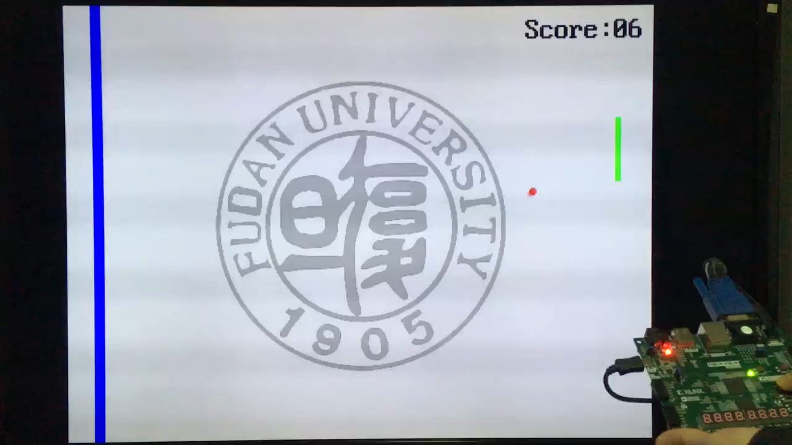
基于FPGA原型的游戏设计
2024-11-17
Notes:
缺陷：得分为十六进制、得分只有个位数变化、按键没有去抖、乒乓球在球拍和右侧屏幕之间没有反弹……

Slide 2
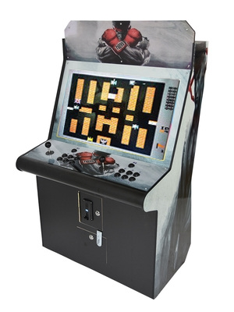
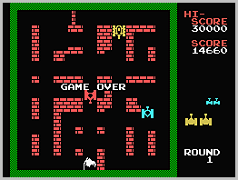
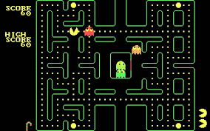
古老的街机游戏 arcade game
Tank Battalion
坦克大战
1980年风靡全球
Pac-Man 吃豆人
Notes:
CPU出现之前，电子游戏街机就已经存在，那时用74系列产品和模拟电路实现。现在我们用FPGA设计这些游戏。

Slide 3
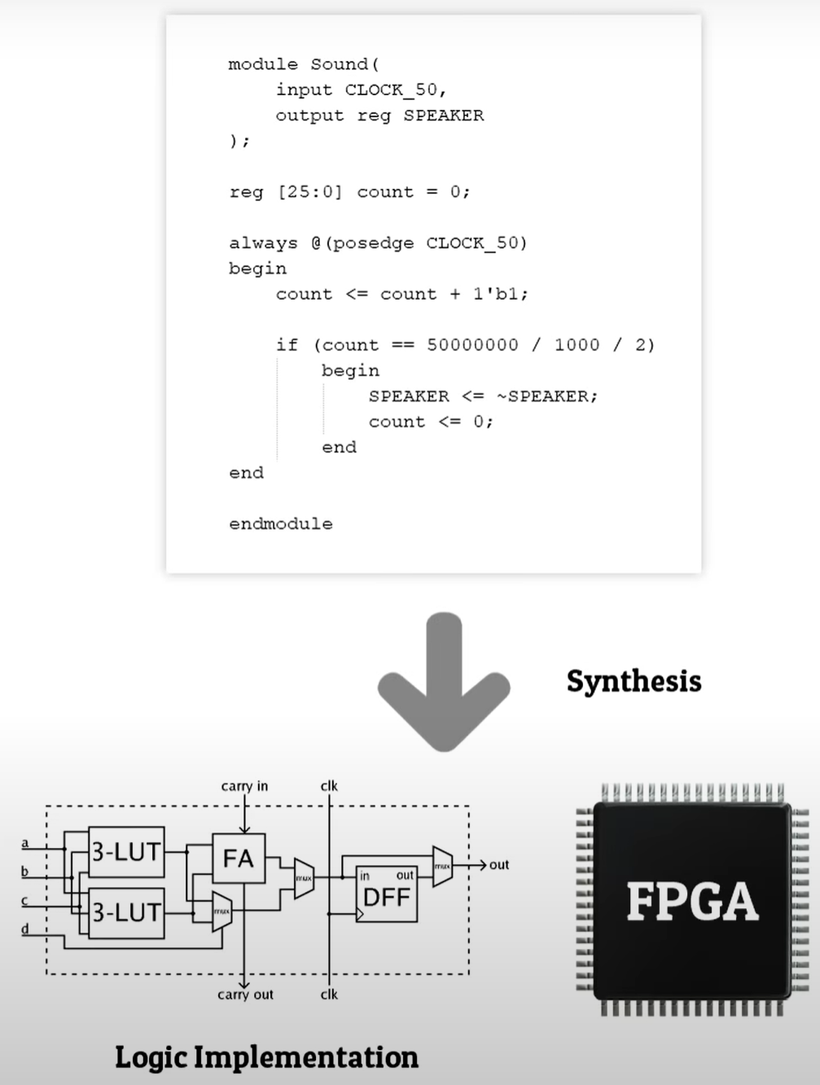
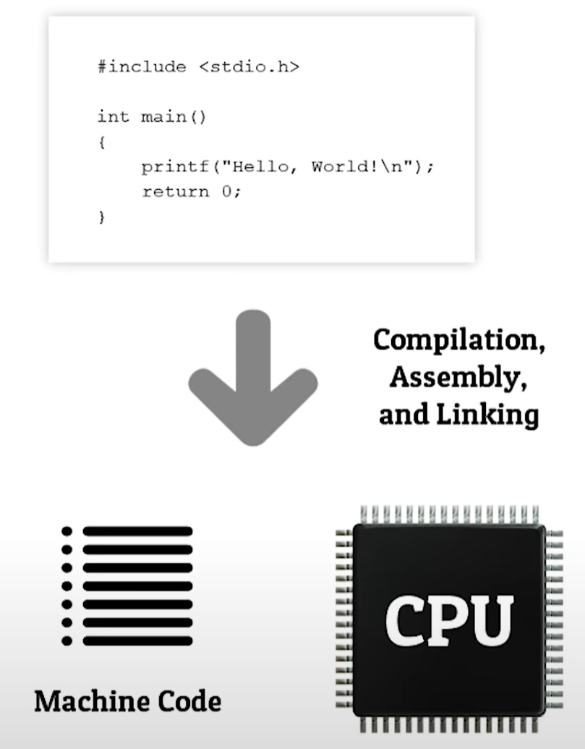
基于FPGA 的设计
a FPGA generally will run faster
没有代码！
Notes:
Things that can be done in stages or have a regular set pattern are great for FPGAs.

Slide 4
VGA
1
VGA

Slide 5
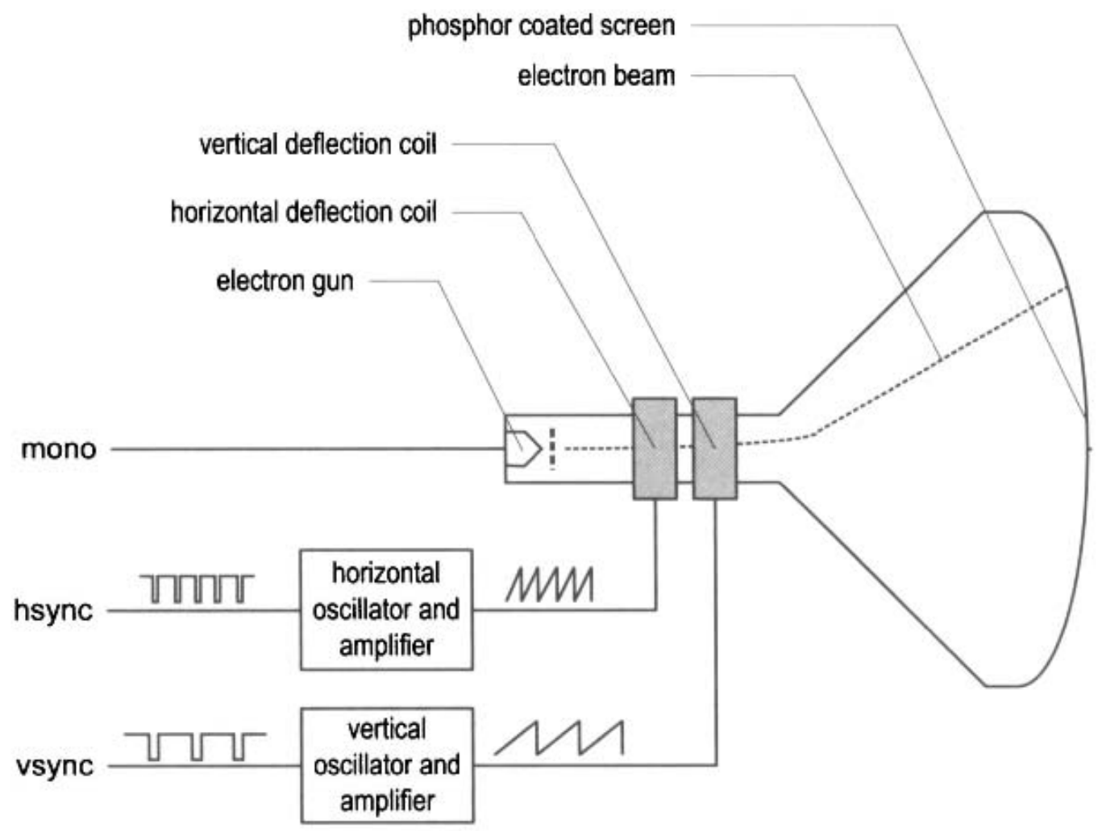
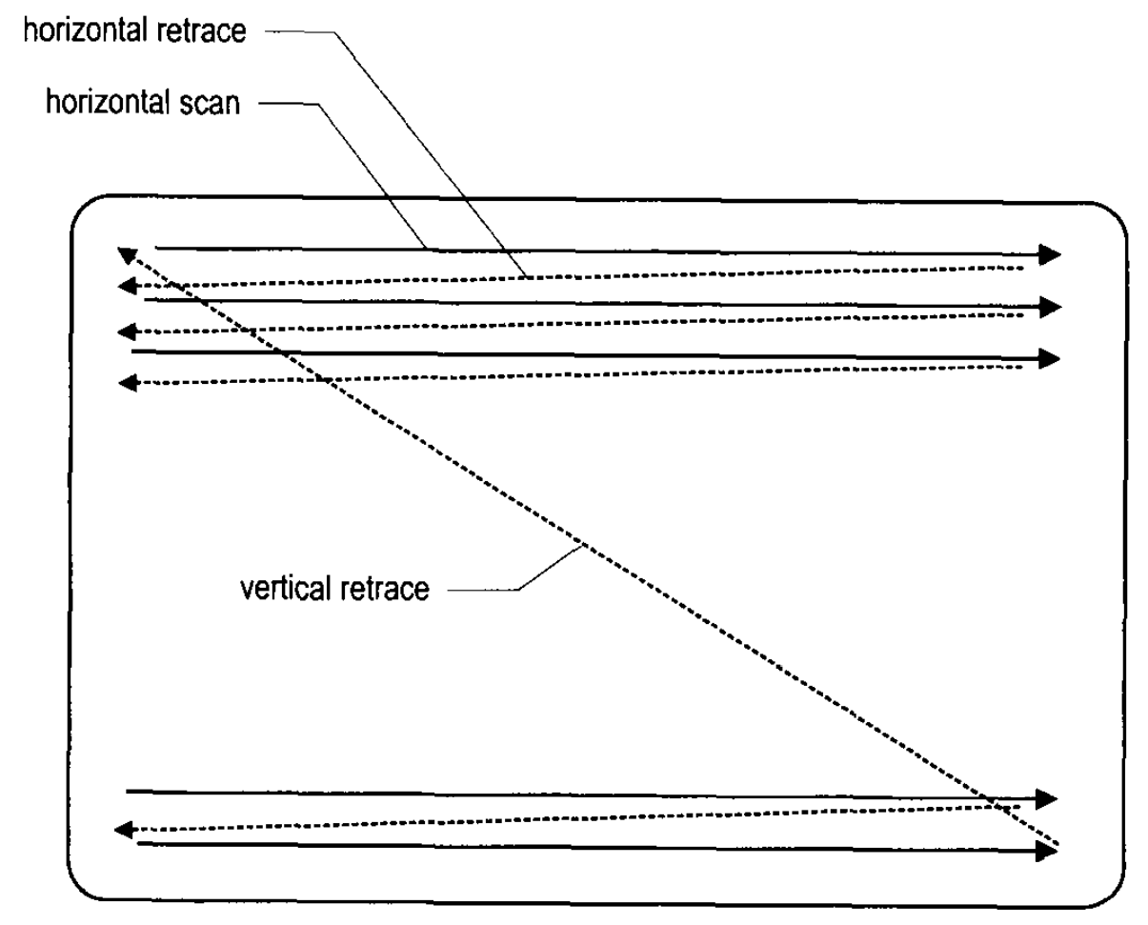
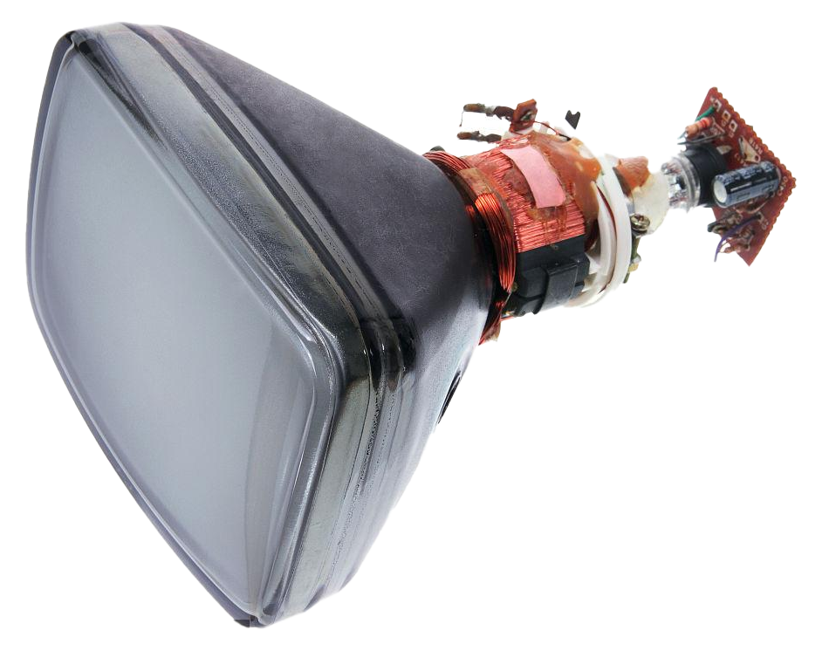
CRT monitor
阴极射线管
CRT scanning patter
hsync信号：标志着每一行的结束，
vsync信号：标志着整个帧的结束。
【参考】教材P346，VGA显示器

Slide 6
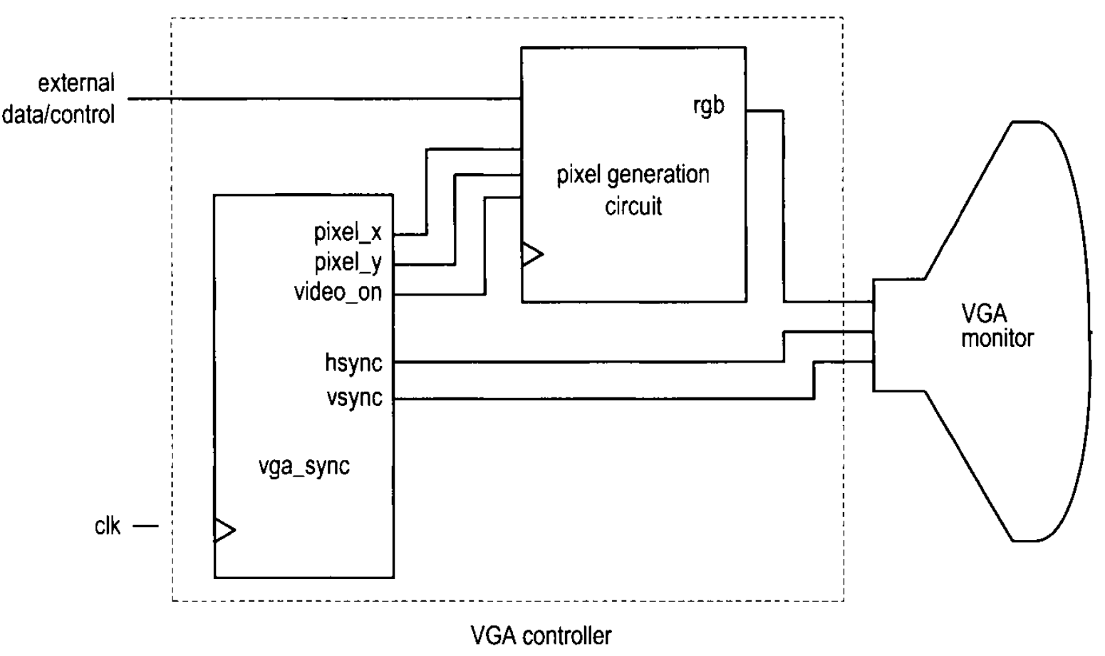
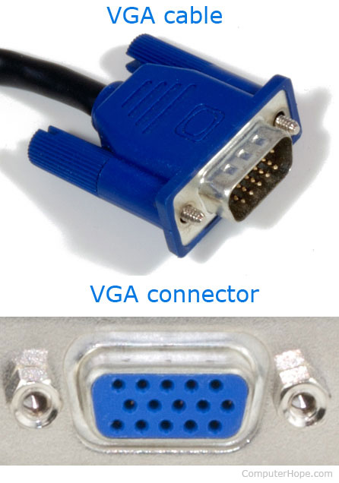
VGA 控制器
Video Graphics Array
产生同步信号 和 串行输出色彩数据。
clr
B G R
vs hs

Slide 7
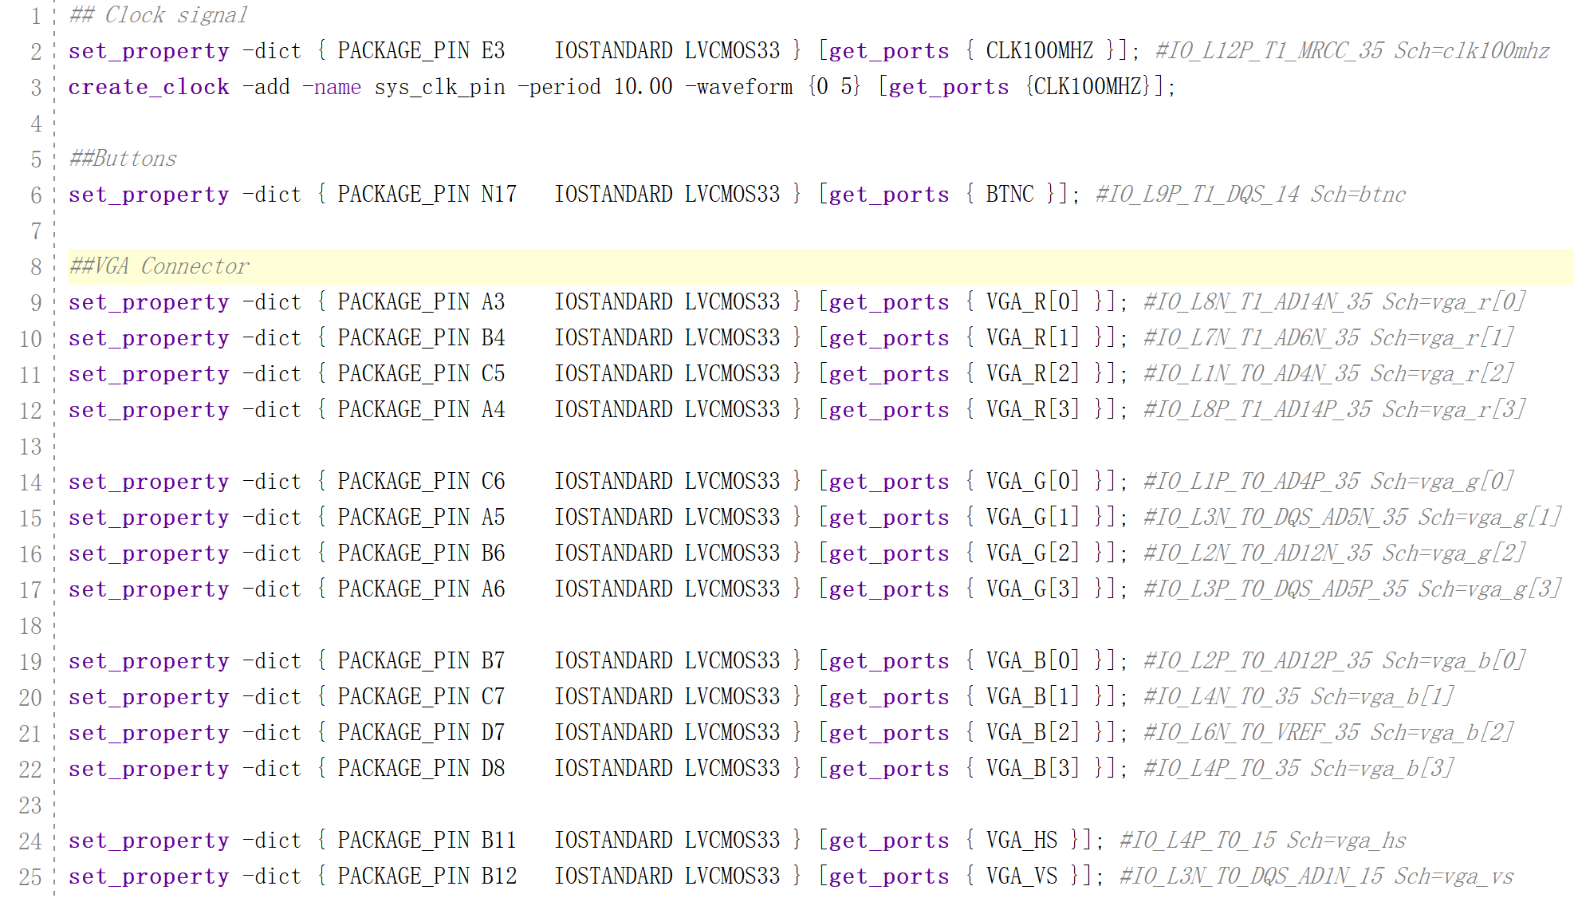
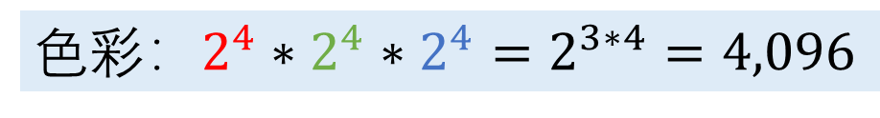
Nexys4 的 VGA 接口(约束文件)
普通图像色彩：$2^{8}∗2^{8}∗2^{8}=2^{3∗8}=16,777,216$
色彩：$2^{4}∗2^{4}∗2^{4}=2^{3∗4}=4,096$
12 bits / pixel
Notes:
## Clock signal
set_property -dict { PACKAGE_PIN E3 IOSTANDARD LVCMOS33 } [get_ports { CLK100MHZ }]; #IO_L12P_T1_MRCC_35 Sch=clk100mhz
create_clock -add -name sys_clk_pin -period 10.00 -waveform {0 5} [get_ports {CLK100MHZ}];
##Buttons
set_property -dict { PACKAGE_PIN N17 IOSTANDARD LVCMOS33 } [get_ports { BTNC }]; #IO_L9P_T1_DQS_14 Sch=btnc
##VGA Connector
set_property -dict { PACKAGE_PIN A3 IOSTANDARD LVCMOS33 } [get_ports { VGA_R[0] }]; #IO_L8N_T1_AD14N_35 Sch=vga_r[0]
set_property -dict { PACKAGE_PIN B4 IOSTANDARD LVCMOS33 } [get_ports { VGA_R[1] }]; #IO_L7N_T1_AD6N_35 Sch=vga_r[1]
set_property -dict { PACKAGE_PIN C5 IOSTANDARD LVCMOS33 } [get_ports { VGA_R[2] }]; #IO_L1N_T0_AD4N_35 Sch=vga_r[2]
set_property -dict { PACKAGE_PIN A4 IOSTANDARD LVCMOS33 } [get_ports { VGA_R[3] }]; #IO_L8P_T1_AD14P_35 Sch=vga_r[3]
set_property -dict { PACKAGE_PIN C6 IOSTANDARD LVCMOS33 } [get_ports { VGA_G[0] }]; #IO_L1P_T0_AD4P_35 Sch=vga_g[0]
set_property -dict { PACKAGE_PIN A5 IOSTANDARD LVCMOS33 } [get_ports { VGA_G[1] }]; #IO_L3N_T0_DQS_AD5N_35 Sch=vga_g[1]
set_property -dict { PACKAGE_PIN B6 IOSTANDARD LVCMOS33 } [get_ports { VGA_G[2] }]; #IO_L2N_T0_AD12N_35 Sch=vga_g[2]
set_property -dict { PACKAGE_PIN A6 IOSTANDARD LVCMOS33 } [get_ports { VGA_G[3] }]; #IO_L3P_T0_DQS_AD5P_35 Sch=vga_g[3]
set_property -dict { PACKAGE_PIN B7 IOSTANDARD LVCMOS33 } [get_ports { VGA_B[0] }]; #IO_L2P_T0_AD12P_35 Sch=vga_b[0]
set_property -dict { PACKAGE_PIN C7 IOSTANDARD LVCMOS33 } [get_ports { VGA_B[1] }]; #IO_L4N_T0_35 Sch=vga_b[1]
set_property -dict { PACKAGE_PIN D7 IOSTANDARD LVCMOS33 } [get_ports { VGA_B[2] }]; #IO_L6N_T0_VREF_35 Sch=vga_b[2]
set_property -dict { PACKAGE_PIN D8 IOSTANDARD LVCMOS33 } [get_ports { VGA_B[3] }]; #IO_L4P_T0_35 Sch=vga_b[3]
set_property -dict { PACKAGE_PIN B11 IOSTANDARD LVCMOS33 } [get_ports { VGA_HS }]; #IO_L4P_T0_15 Sch=vga_hs
set_property -dict { PACKAGE_PIN B12 IOSTANDARD LVCMOS33 } [get_ports { VGA_VS }]; #IO_L3N_T0_DQS_AD1N_15 Sch=vga_vs

Slide 8
VGA原理 – 640x480@60Hz
$$60Hz∗521lines∗800pixels≈25MHz$$
H-Sync
Time
Vertical Sync 场同步信号
retrace
2 行
消隐期GRB均为0
场显示后沿
Vertical Blank (Top)
V-Sync
29 行
H-Sync
行同步信号
行显示
后沿
Horizontal Back Porch
视频显示区域
Active Video Area
640 x 480
行显示 前沿
Horizontal Front Porch
(0, 0)
521行
480 行
96 像素
48像素
640 像素
16像素
retrace
场显示前沿 Vertical Blank (Bottom)
10 行
800 像素
Notes:
29行？33行？根据NEXYS4 DDR电子文档，选择29行！
1）在每条水平扫描的末端，电子枪必须关闭一段时间（水平消隐间隔retrace），以便返回到下一条扫描的开头。
2）所有扫描线完成后，电子枪必须再次关闭一段时间（垂直消隐间隔retrace），以便返回到屏幕左上角。

Slide 9
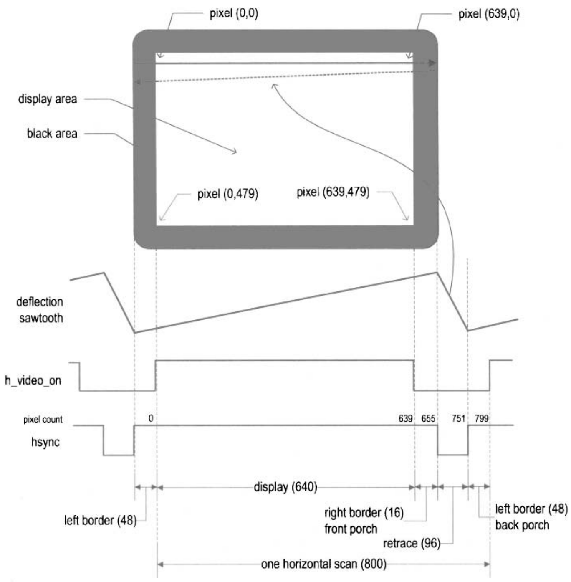
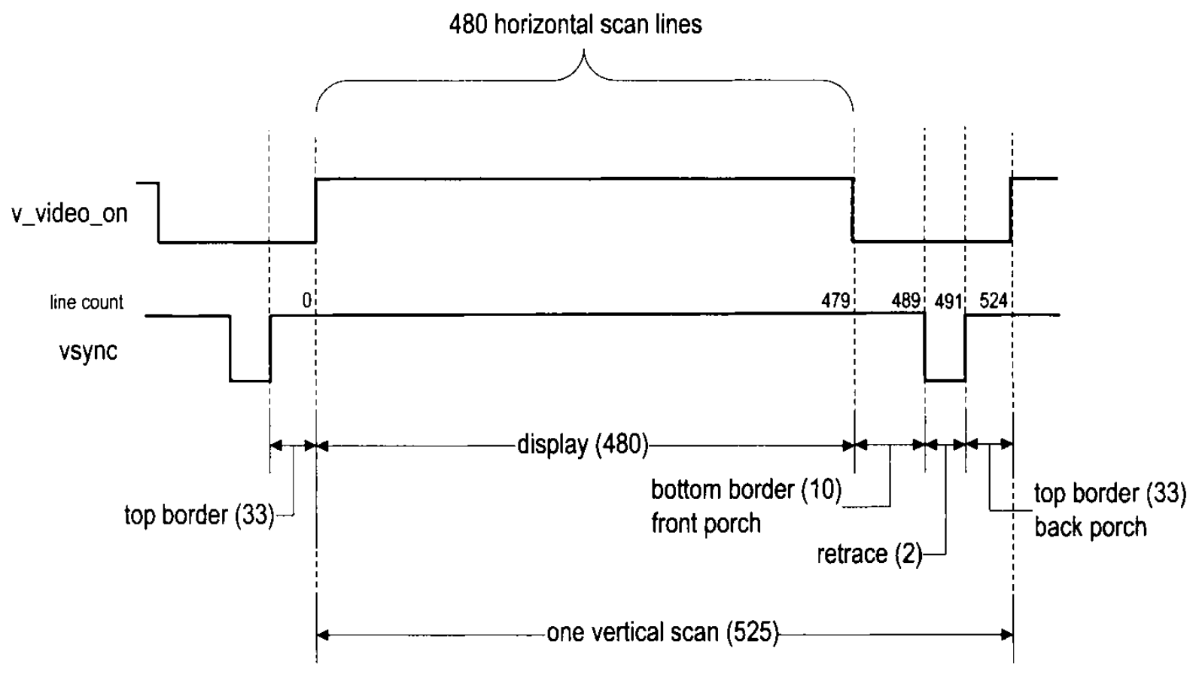
水平扫描、垂直扫描

Slide 10
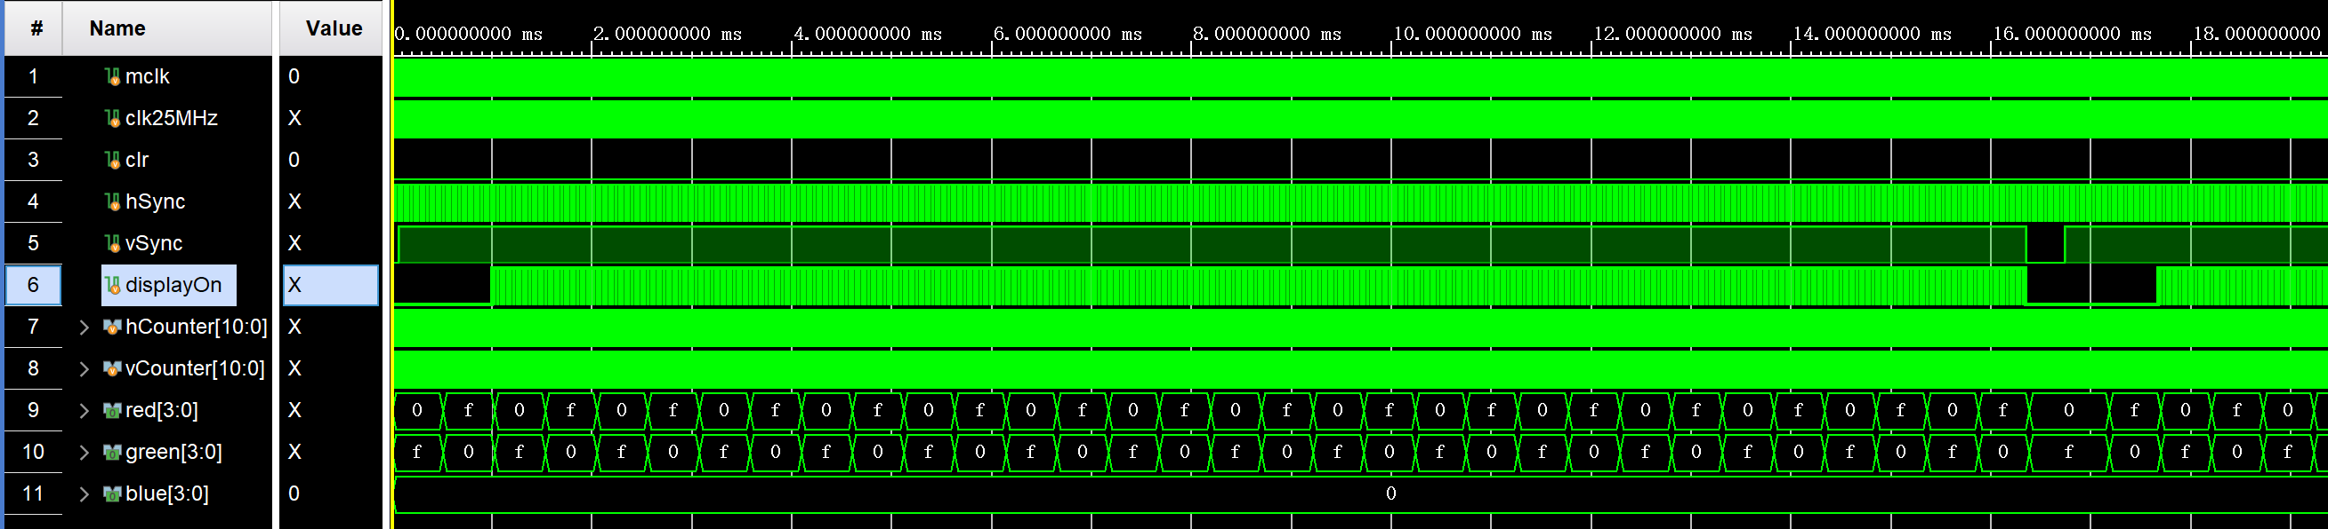
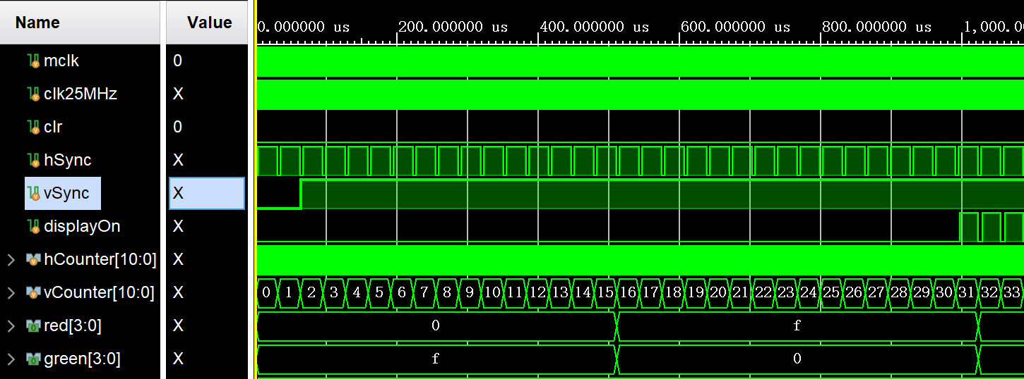
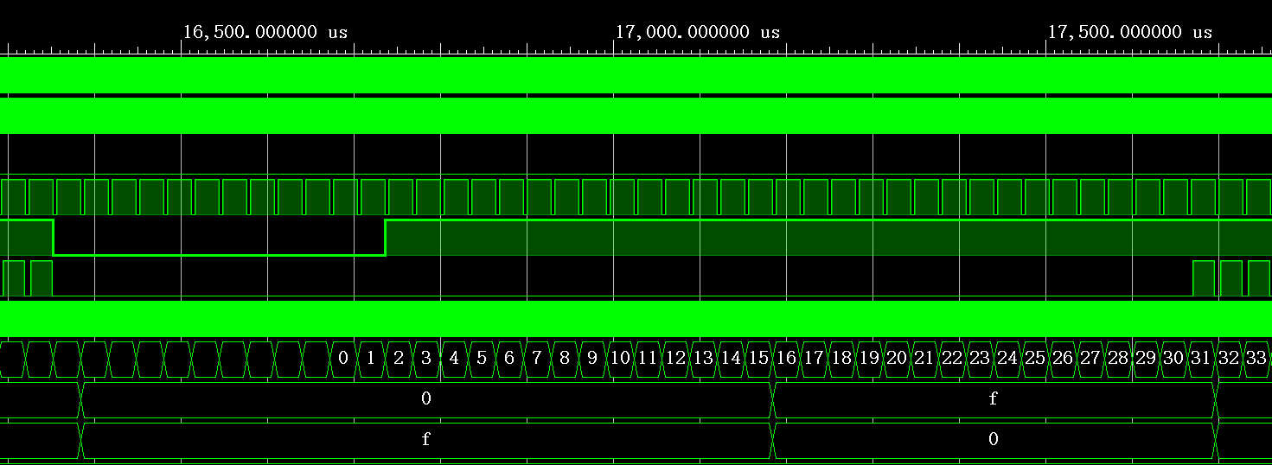
vSync 场同步 (640x480)
2行
2行
29 行
480行
10 行
Notes:
每行640个显示像素，加上隐藏不显示的像素，共计800个。

Slide 11
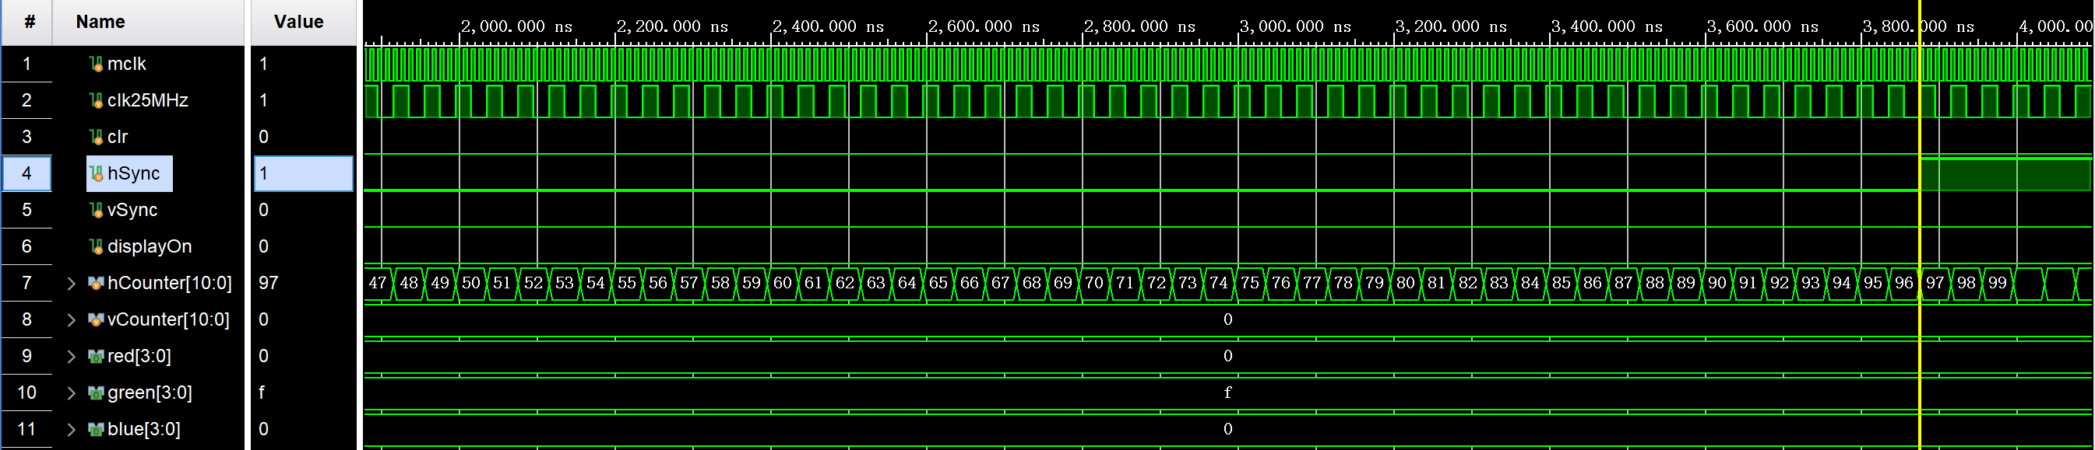
hSync 行同步 (640x480)
2行
29 行
行同步信号需要：96个脉冲，96个像素
Notes:
https://en.wikipedia.org/wiki/Video_Graphics_Array

Slide 12
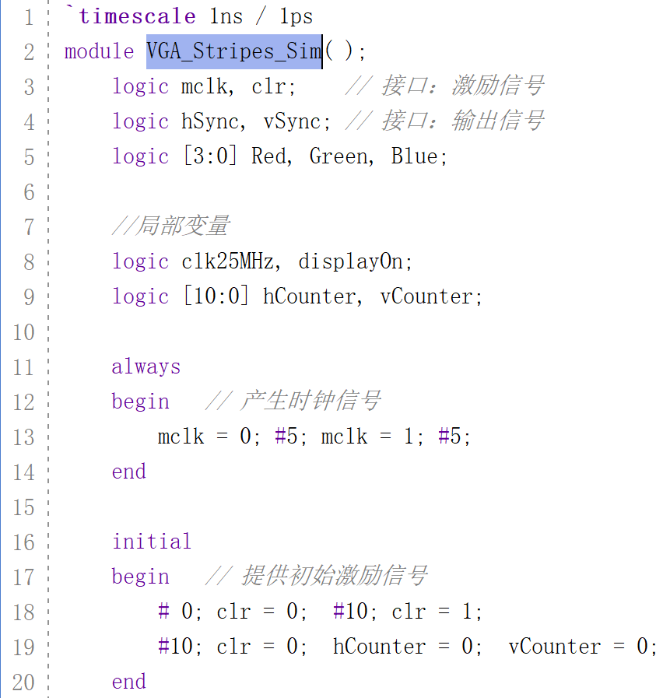
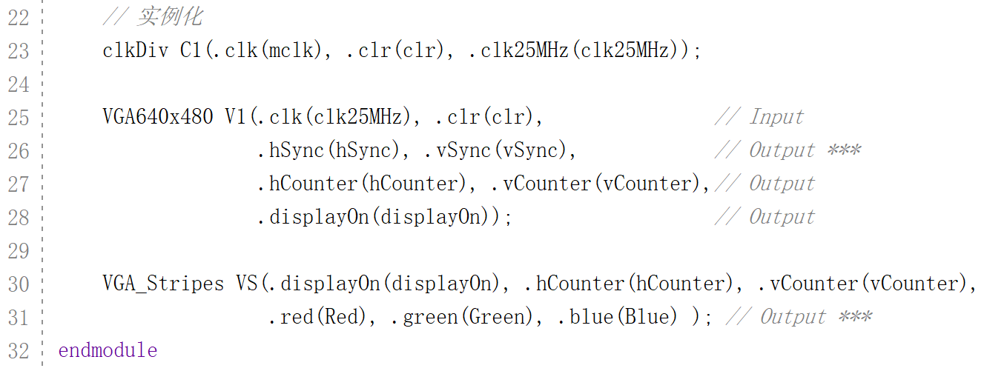
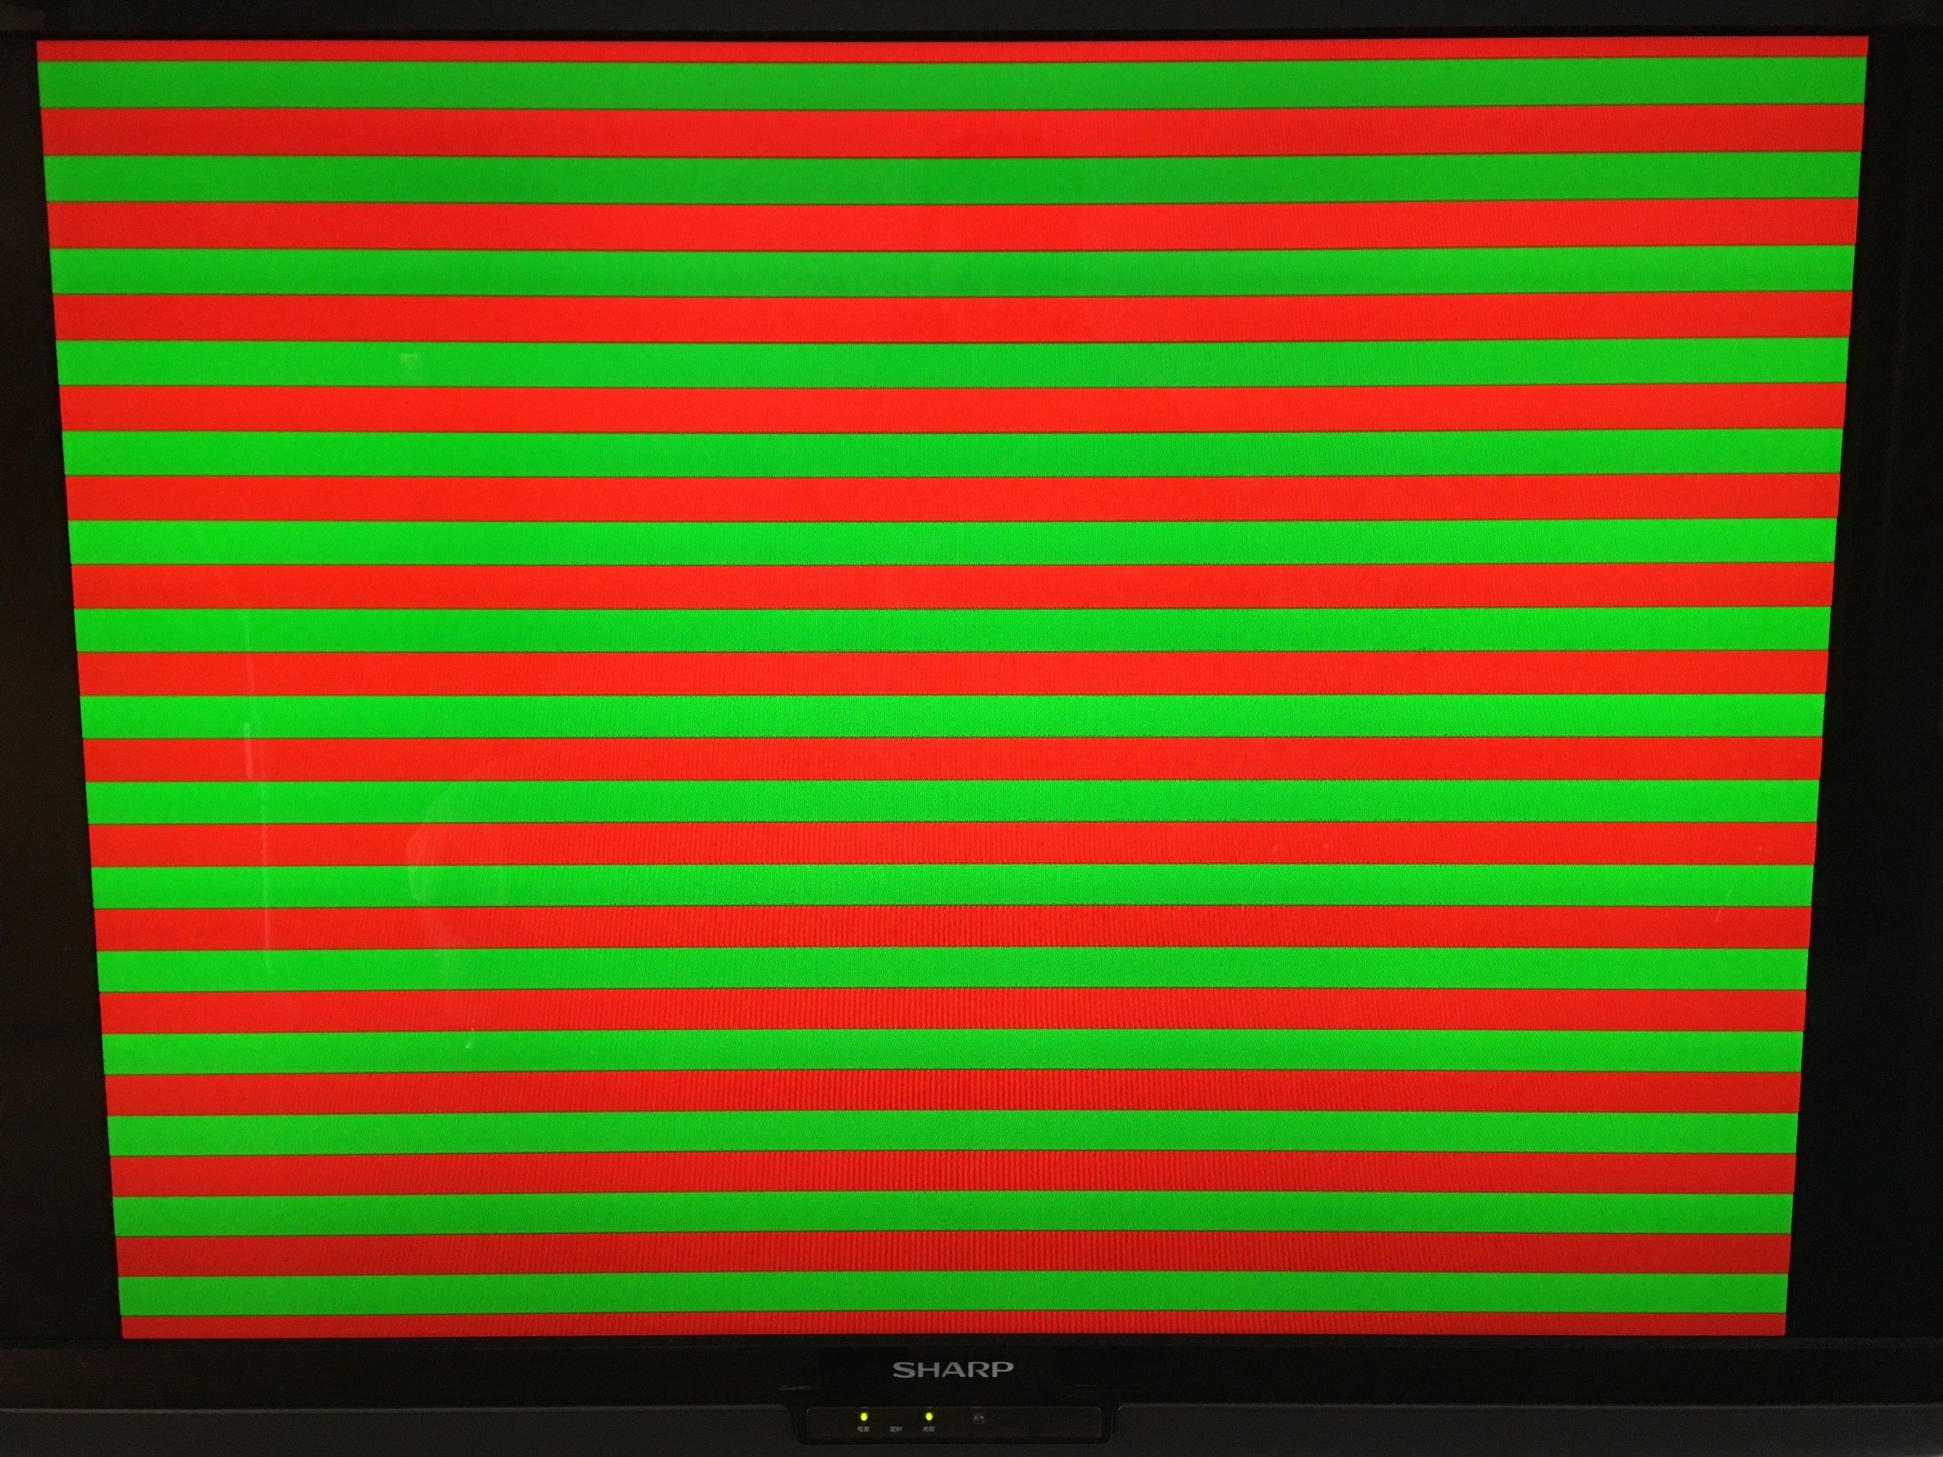
仿真代码
Notes:
`timescale 1ns / 1ps
module VGA_Stripes_Sim( );
logic mclk, clr; // 接口：激励信号
logic hSync, vSync; // 接口：输出信号
logic [3:0] Red, Green, Blue;
//局部变量
logic clk25MHz, displayOn;
logic [10:0] hCounter, vCounter;
always
begin // 产生时钟信号
mclk = 0; #5; mclk = 1; #5;
end
initial
begin // 提供初始激励信号
# 0; clr = 0; #10; clr = 1;
#10; clr = 0; hCounter = 0; vCounter = 0;
end
// 实例化
clkDiv C1(.clk(mclk), .clr(clr), .clk25MHz(clk25MHz));
VGA640x480 V1(.clk(clk25MHz), .clr(clr), // Input
.hSync(hSync), .vSync(vSync), // Output ***
.hCounter(hCounter), .vCounter(vCounter),// Output
.displayOn(displayOn)); // Output
VGA_Stripes VS(.displayOn(displayOn), .hCounter(hCounter), .vCounter(vCounter),
.red(Red), .green(Green), .blue(Blue) ); // Output ***
endmodule

Slide 13
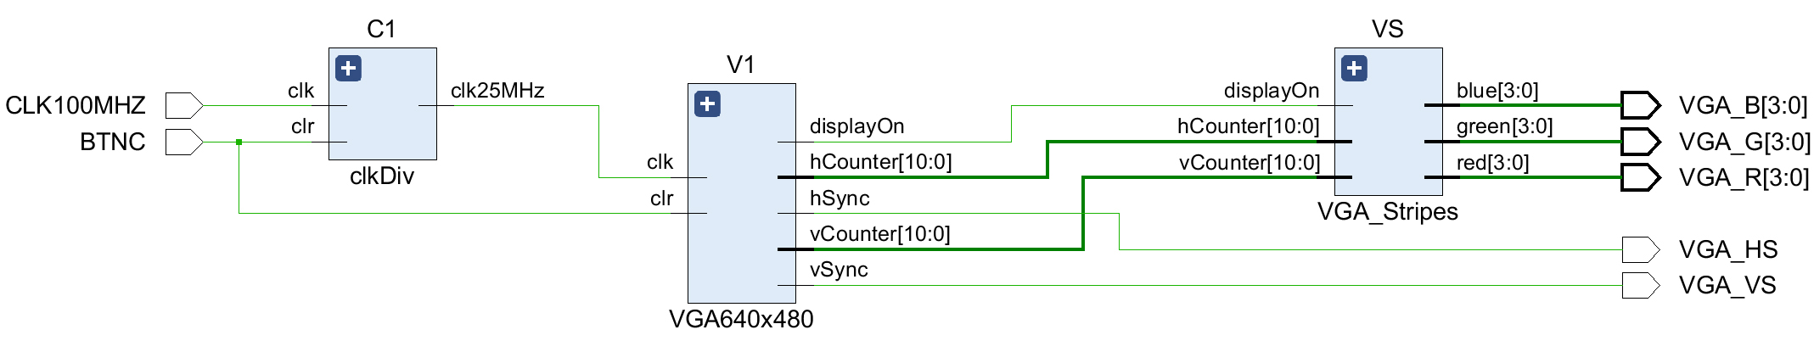
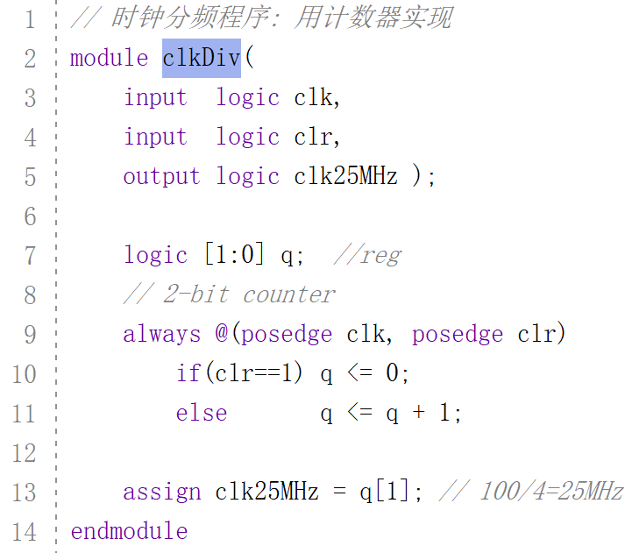
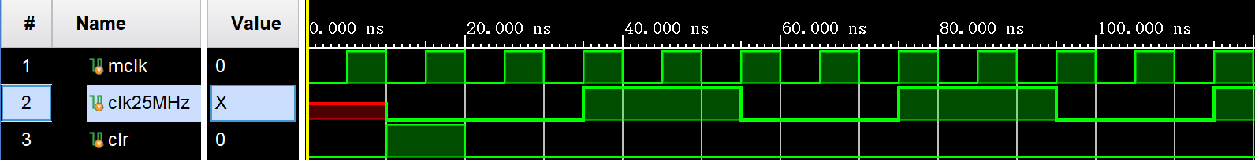
25MHz时钟分频模块
Notes:
// 时钟分频程序: 用计数器实现
module clkDiv(
input logic clk,
input logic clr,
output logic clk25MHz );
logic [1:0] q; //reg
// 2-bit counter
always @(posedge clk, posedge clr)
if(clr==1) q <= 0;
else q <= q + 1;
assign clk25MHz = q[1]; // 100/4=25MHz
endmodule

Slide 14
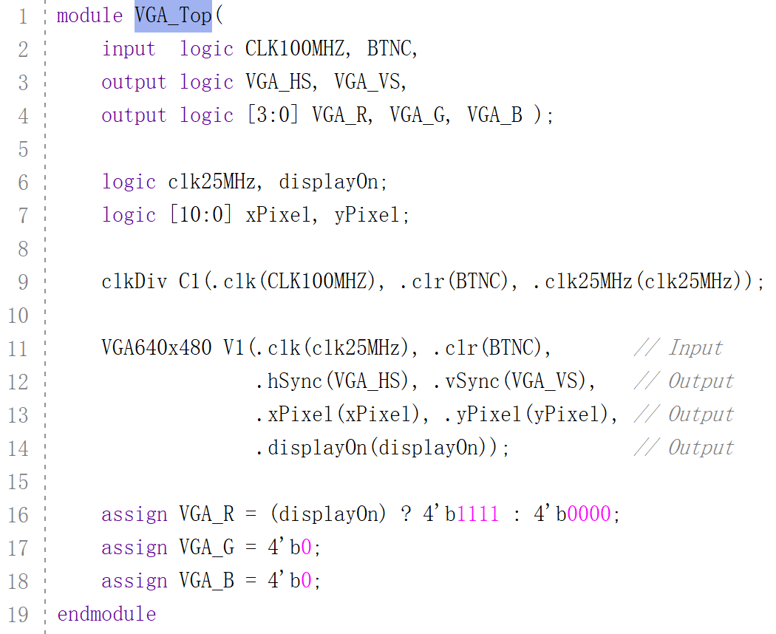
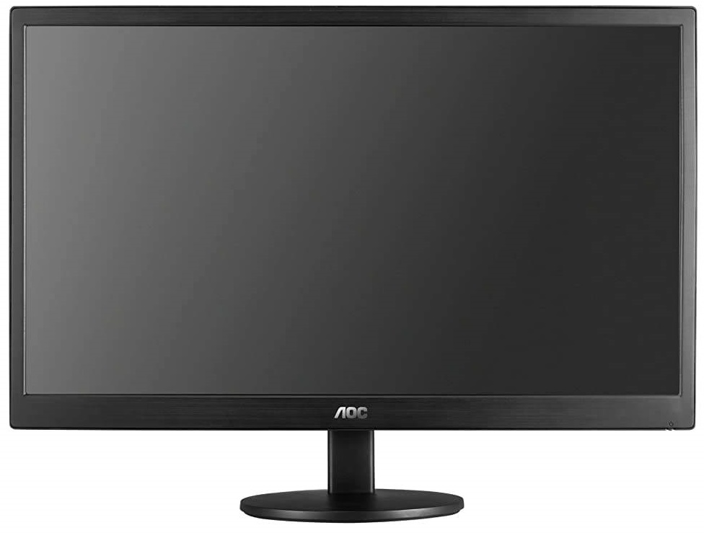
VGA 顶层文件
C1
V1
displayOn
VGA_R
CLK100MHZ
clk
clk25MHz
clk
VGA_G
clr
xPixel
VGA_B
BTNC
yPixel
clkDiv
hSync
VGA_HS
clr
vSync
VGA_VS
VGA640x480
Notes:
module VGA_Top(
input logic CLK100MHZ, BTNC,
output logic VGA_HS, VGA_VS,
output logic [3:0] VGA_R, VGA_G, VGA_B );
logic clk25MHz, displayOn;
logic [10:0] xPixel, yPixel;
clkDiv C1(.clk(CLK100MHZ), .clr(BTNC), .clk25MHz(clk25MHz));
VGA640x480 V1(.clk(clk25MHz), .clr(BTNC), // Input
.hSync(VGA_HS), .vSync(VGA_VS), // Output
.xPixel(xPixel), .yPixel(yPixel), // Output
.displayOn(displayOn)); // Output
assign VGA_R = (displayOn) ? 4'b1111 : 4'b0000;
assign VGA_G = 4'b0;
assign VGA_B = 4'b0;
endmodule

Slide 15
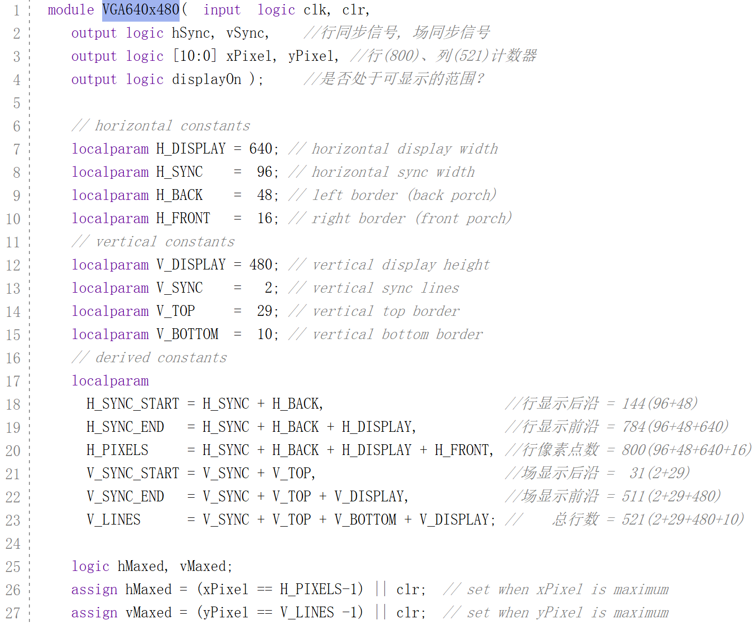
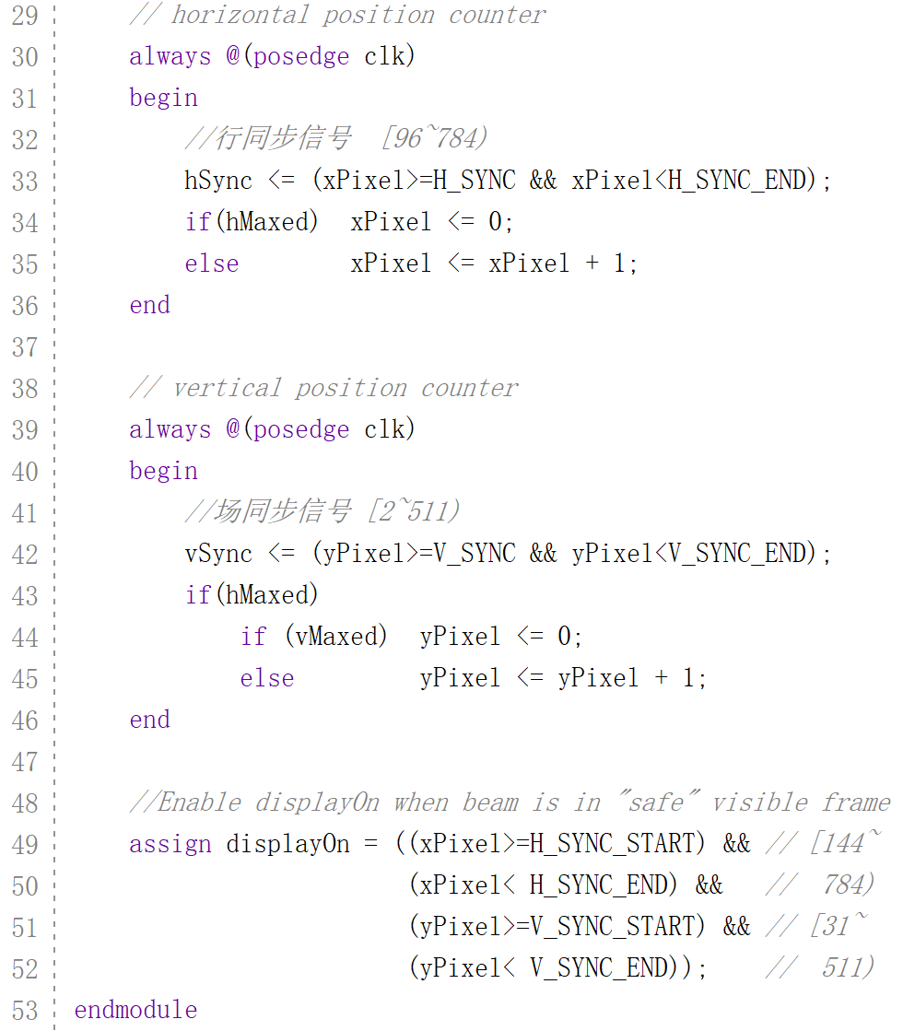
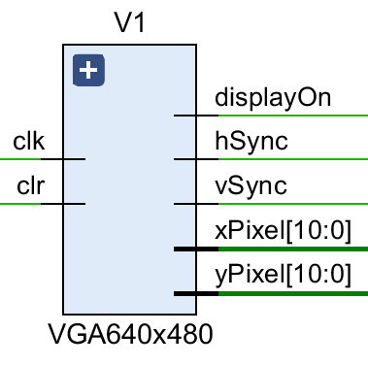
VGA 模块 (640x480)
Notes:
localparam(与 parameter 值不同，此值不能通过参数重新定义或 defparam 语句修改) 背后的想法(添加到 Verilog-2001 标准中)是为了保护 localparam 的值最终用户意外或不正确的重新定义。
module VGA640x480( input logic clk, clr,
output logic hSync, vSync, //行同步信号, 场同步信号
output logic [10:0] xPixel, yPixel, //行(800)、列(521)计数器
output logic displayOn ); //是否处于可显示的范围？
// horizontal constants
localparam H_DISPLAY = 640; // horizontal display width
localparam H_SYNC = 96; // horizontal sync width
localparam H_BACK = 48; // left border (back porch)
localparam H_FRONT = 16; // right border (front porch)
// vertical constants
localparam V_DISPLAY = 480; // vertical display height
localparam V_SYNC = 2; // vertical sync lines
localparam V_TOP = 29; // vertical top border
localparam V_BOTTOM = 10; // vertical bottom border
// derived constants
localparam
H_SYNC_START = H_SYNC + H_BACK, //行显示后沿 = 144(96+48)
H_SYNC_END = H_SYNC + H_BACK + H_DISPLAY, //行显示前沿 = 784(96+48+640)
H_PIXELS = H_SYNC + H_BACK + H_DISPLAY + H_FRONT, //行像素点数 = 800(96+48+640+16)
V_SYNC_START = V_SYNC + V_TOP, //场显示后沿 = 31(2+29)
V_SYNC_END = V_SYNC + V_TOP + V_DISPLAY, //场显示前沿 = 511(2+29+480)
V_LINES = V_SYNC + V_TOP + V_BOTTOM + V_DISPLAY; // 总行数 = 521(2+29+480+10)
logic hMaxed, vMaxed;
assign hMaxed = (xPixel == H_PIXELS-1) || clr; // set when xPixel is maximum
assign vMaxed = (yPixel == V_LINES -1) || clr; // set when yPixel is maximum
// horizontal position counter
always @(posedge clk)
begin
//行同步信号 [96~784)
hSync <= (xPixel>=H_SYNC && xPixel<H_SYNC_END);
if(hMaxed) xPixel <= 0;
else xPixel <= xPixel + 1;
end
// vertical position counter
always @(posedge clk)
begin
//场同步信号 [2~511)
vSync <= (yPixel>=V_SYNC && yPixel<V_SYNC_END);
if(hMaxed)
if (vMaxed) yPixel <= 0;
else yPixel <= yPixel + 1;
end
//Enable displayOn when beam is in "safe" visible frame
assign displayOn = ((xPixel>=H_SYNC_START) && // [144~
(xPixel< H_SYNC_END) && // 784)
(yPixel>=V_SYNC_START) && // [31~
(yPixel< V_SYNC_END)); // 511)
endmodule

Slide 16
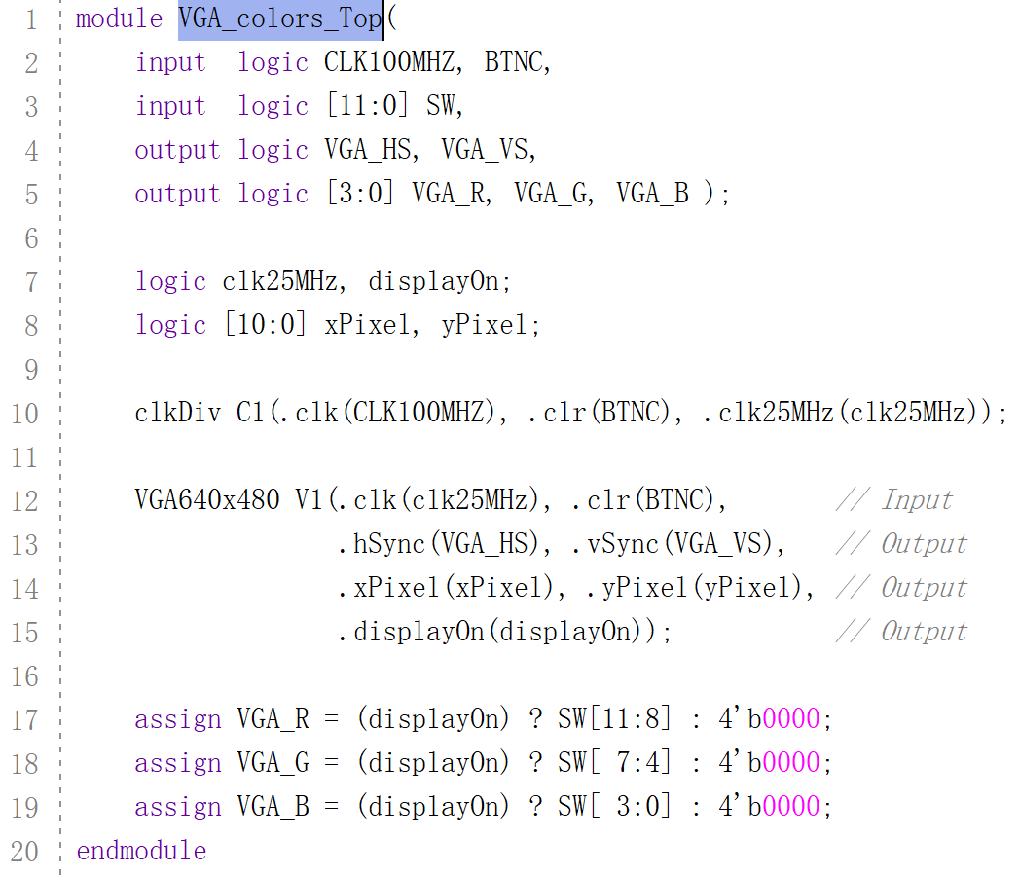
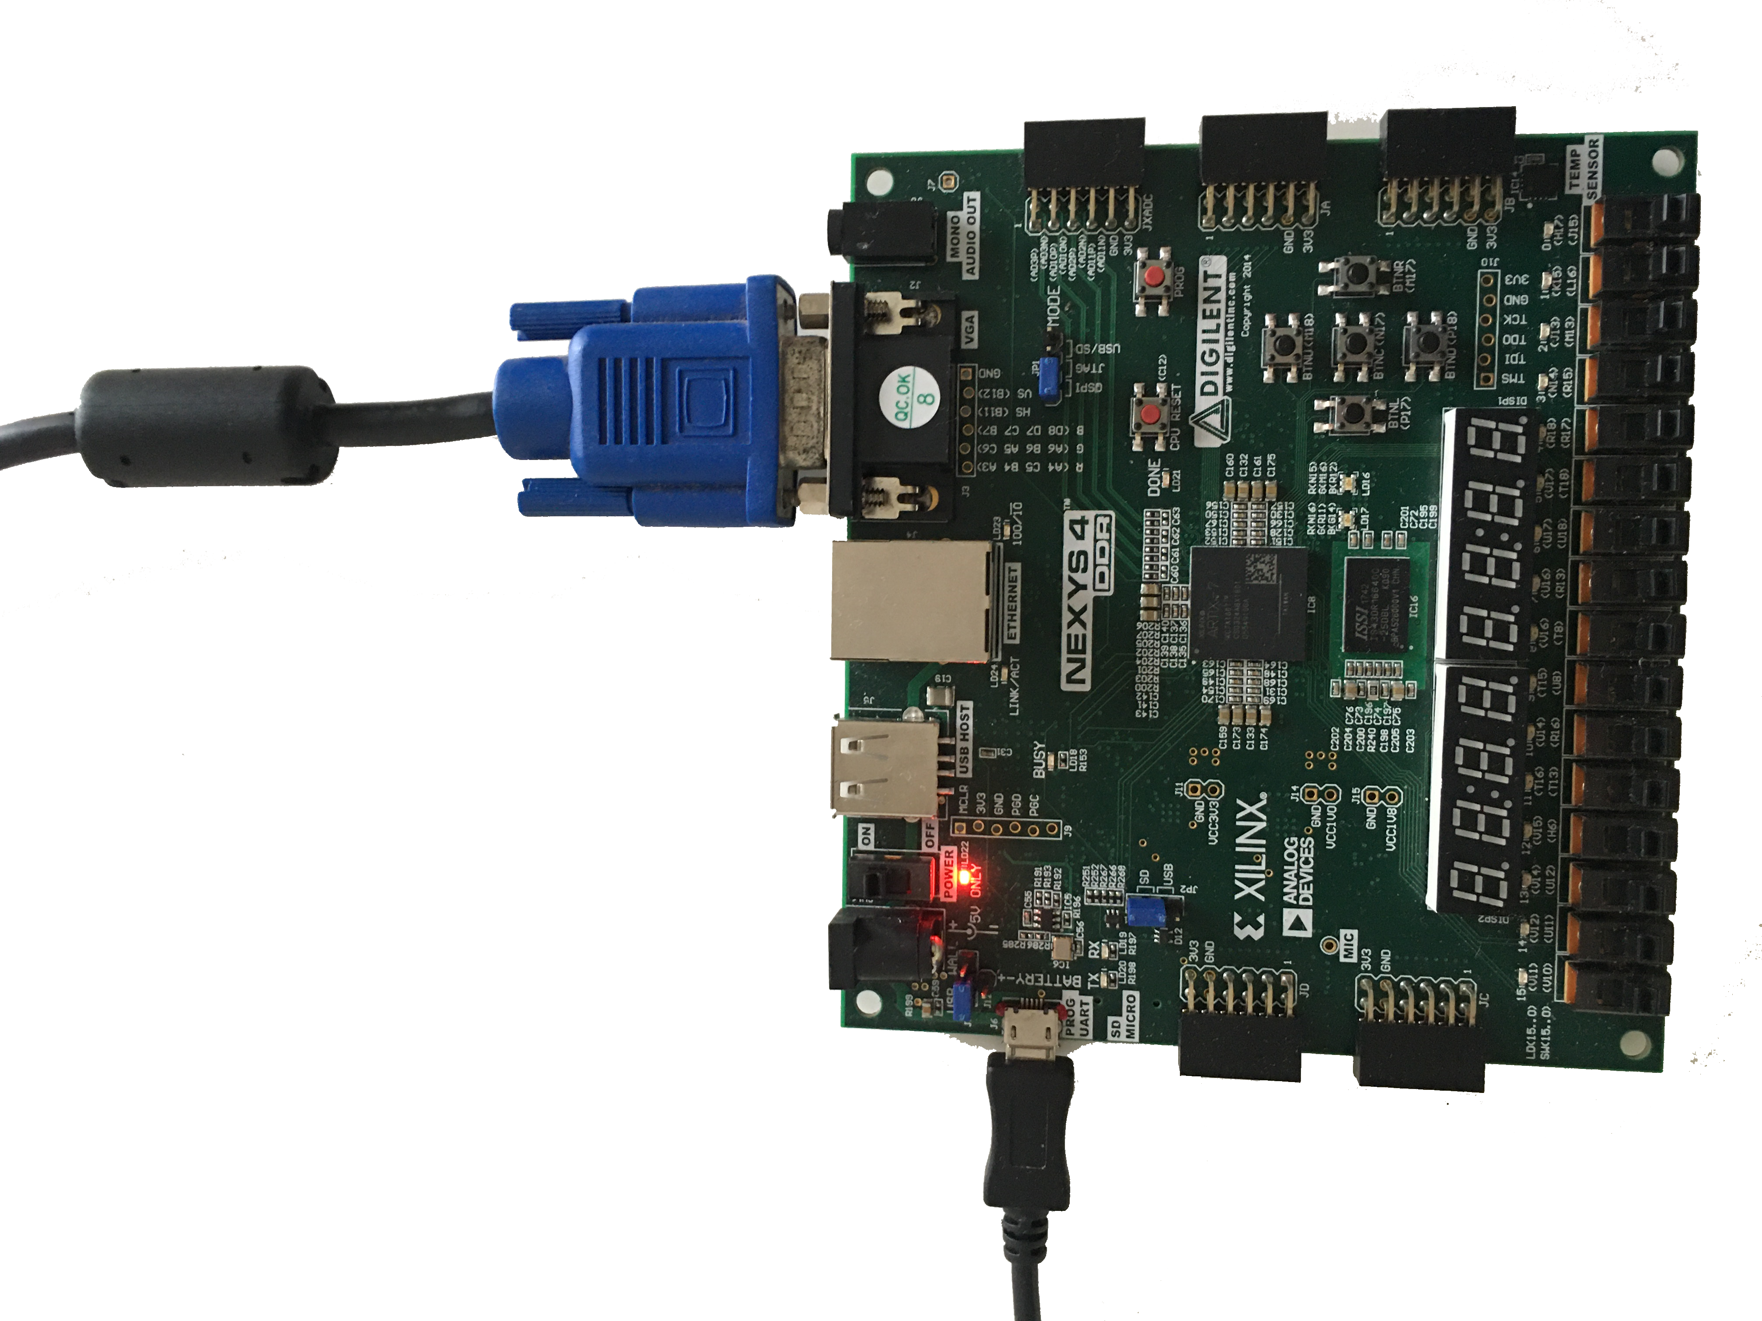
VGA -colors 顶层文件
Notes:
module VGA_colors_Top(
input logic CLK100MHZ, BTNC,
input logic [11:0] SW,
output logic VGA_HS, VGA_VS,
output logic [3:0] VGA_R, VGA_G, VGA_B );
logic clk25MHz, displayOn;
logic [10:0] xPixel, yPixel;
clkDiv C1(.clk(CLK100MHZ), .clr(BTNC), .clk25MHz(clk25MHz));
VGA640x480 V1(.clk(clk25MHz), .clr(BTNC), // Input
.hSync(VGA_HS), .vSync(VGA_VS), // Output
.xPixel(xPixel), .yPixel(yPixel), // Output
.displayOn(displayOn)); // Output
assign VGA_R = (displayOn) ? SW[11:8] : 4'b0000;
assign VGA_G = (displayOn) ? SW[ 7:4] : 4'b0000;
assign VGA_B = (displayOn) ? SW[ 3:0] : 4'b0000;
endmodule

Slide 17
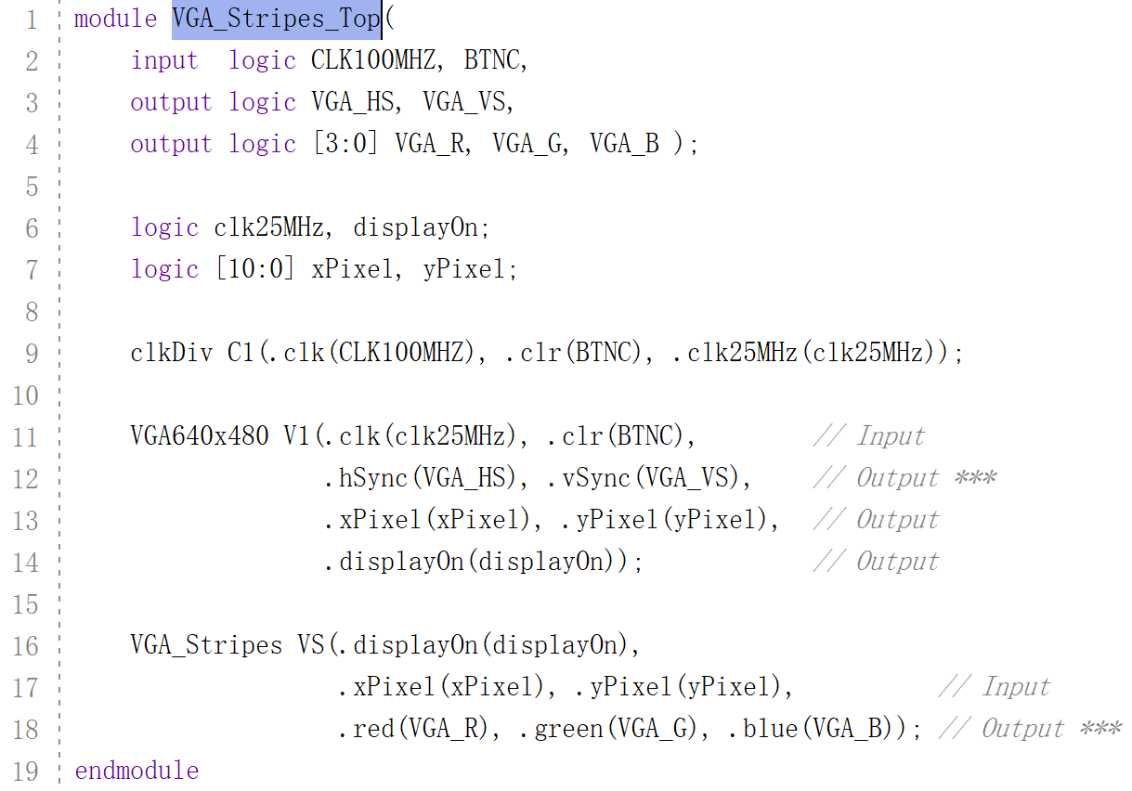
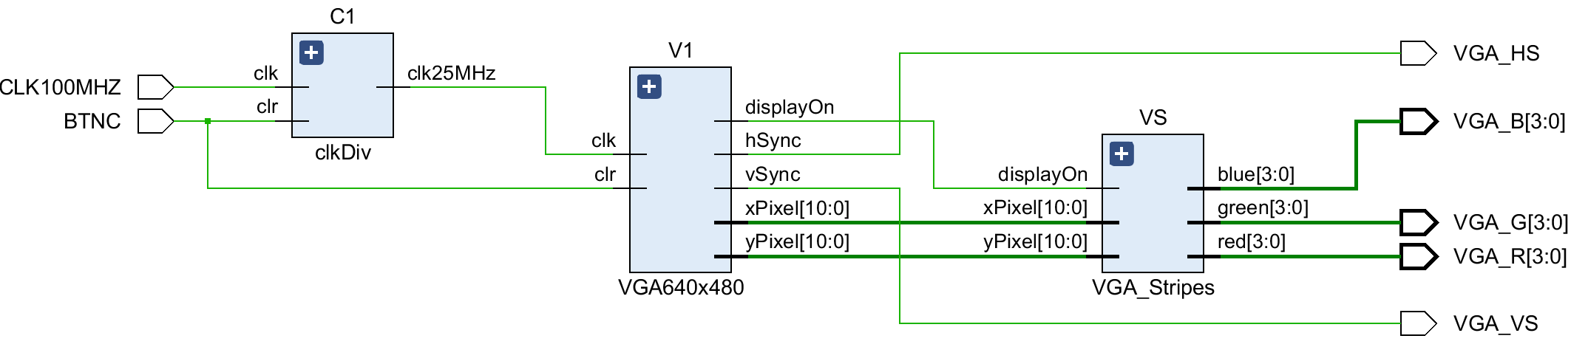
VGA -stripes顶层文件
Notes:
module VGA_Stripes_Top(
input logic CLK100MHZ, BTNC,
output logic VGA_HS, VGA_VS,
output logic [3:0] VGA_R, VGA_G, VGA_B );
logic clk25MHz, displayOn;
logic [10:0] xPixel, yPixel;
clkDiv C1(.clk(CLK100MHZ), .clr(BTNC), .clk25MHz(clk25MHz));
VGA640x480 V1(.clk(clk25MHz), .clr(BTNC), // Input
.hSync(VGA_HS), .vSync(VGA_VS), // Output ***
.xPixel(xPixel), .yPixel(yPixel), // Output
.displayOn(displayOn)); // Output
VGA_Stripes VS(.displayOn(displayOn),
.xPixel(xPixel), .yPixel(yPixel), // Input
.red(VGA_R), .green(VGA_G), .blue(VGA_B)); // Output ***
endmodule

Slide 18
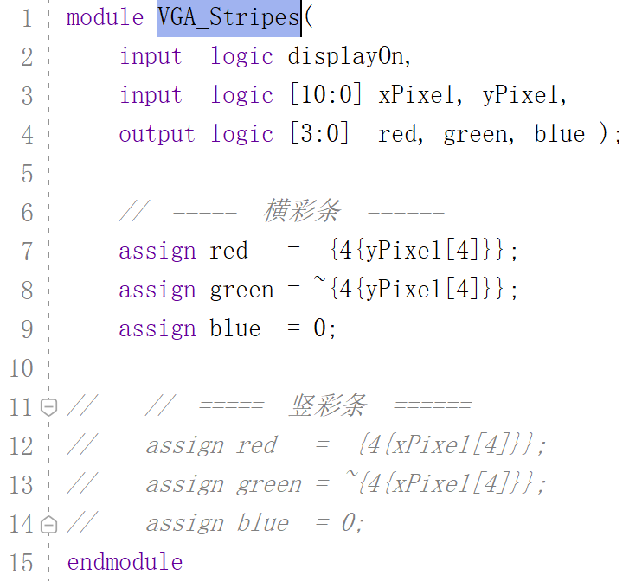
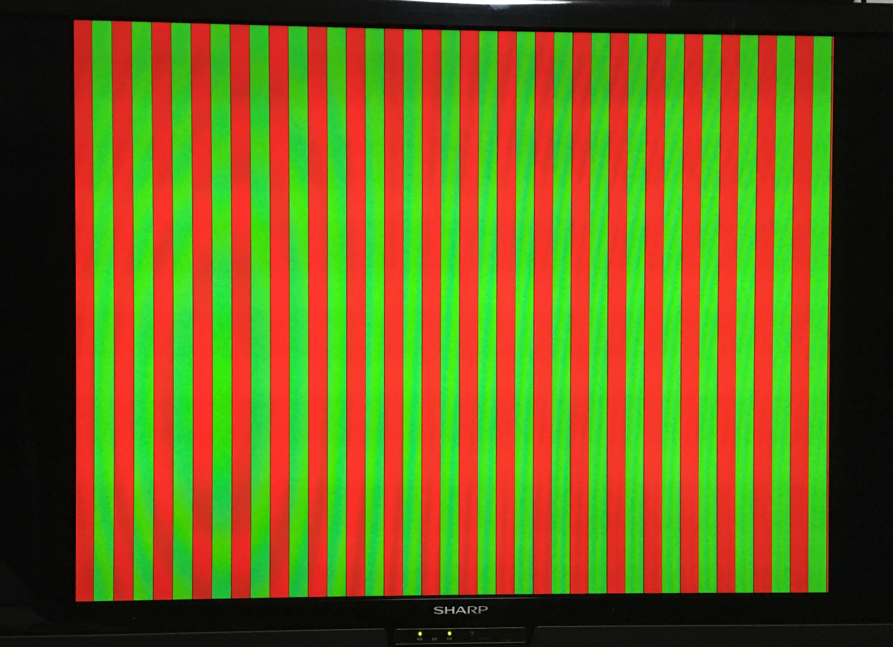
VGA – stripes模块
32像素
15条绿色
Notes:
module VGA_Stripes(
input logic displayOn,
input logic [10:0] xPixel, yPixel,
output logic [3:0] red, green, blue );
// ===== 横彩条 ======
assign red = {4{yPixel[4]}};
assign green = ~{4{yPixel[4]}};
assign blue = 0;
// // ===== 竖彩条 ======
// assign red = {4{xPixel[4]}};
// assign green = ~{4{xPixel[4]}};
// assign blue = 0;
endmodule

Slide 19
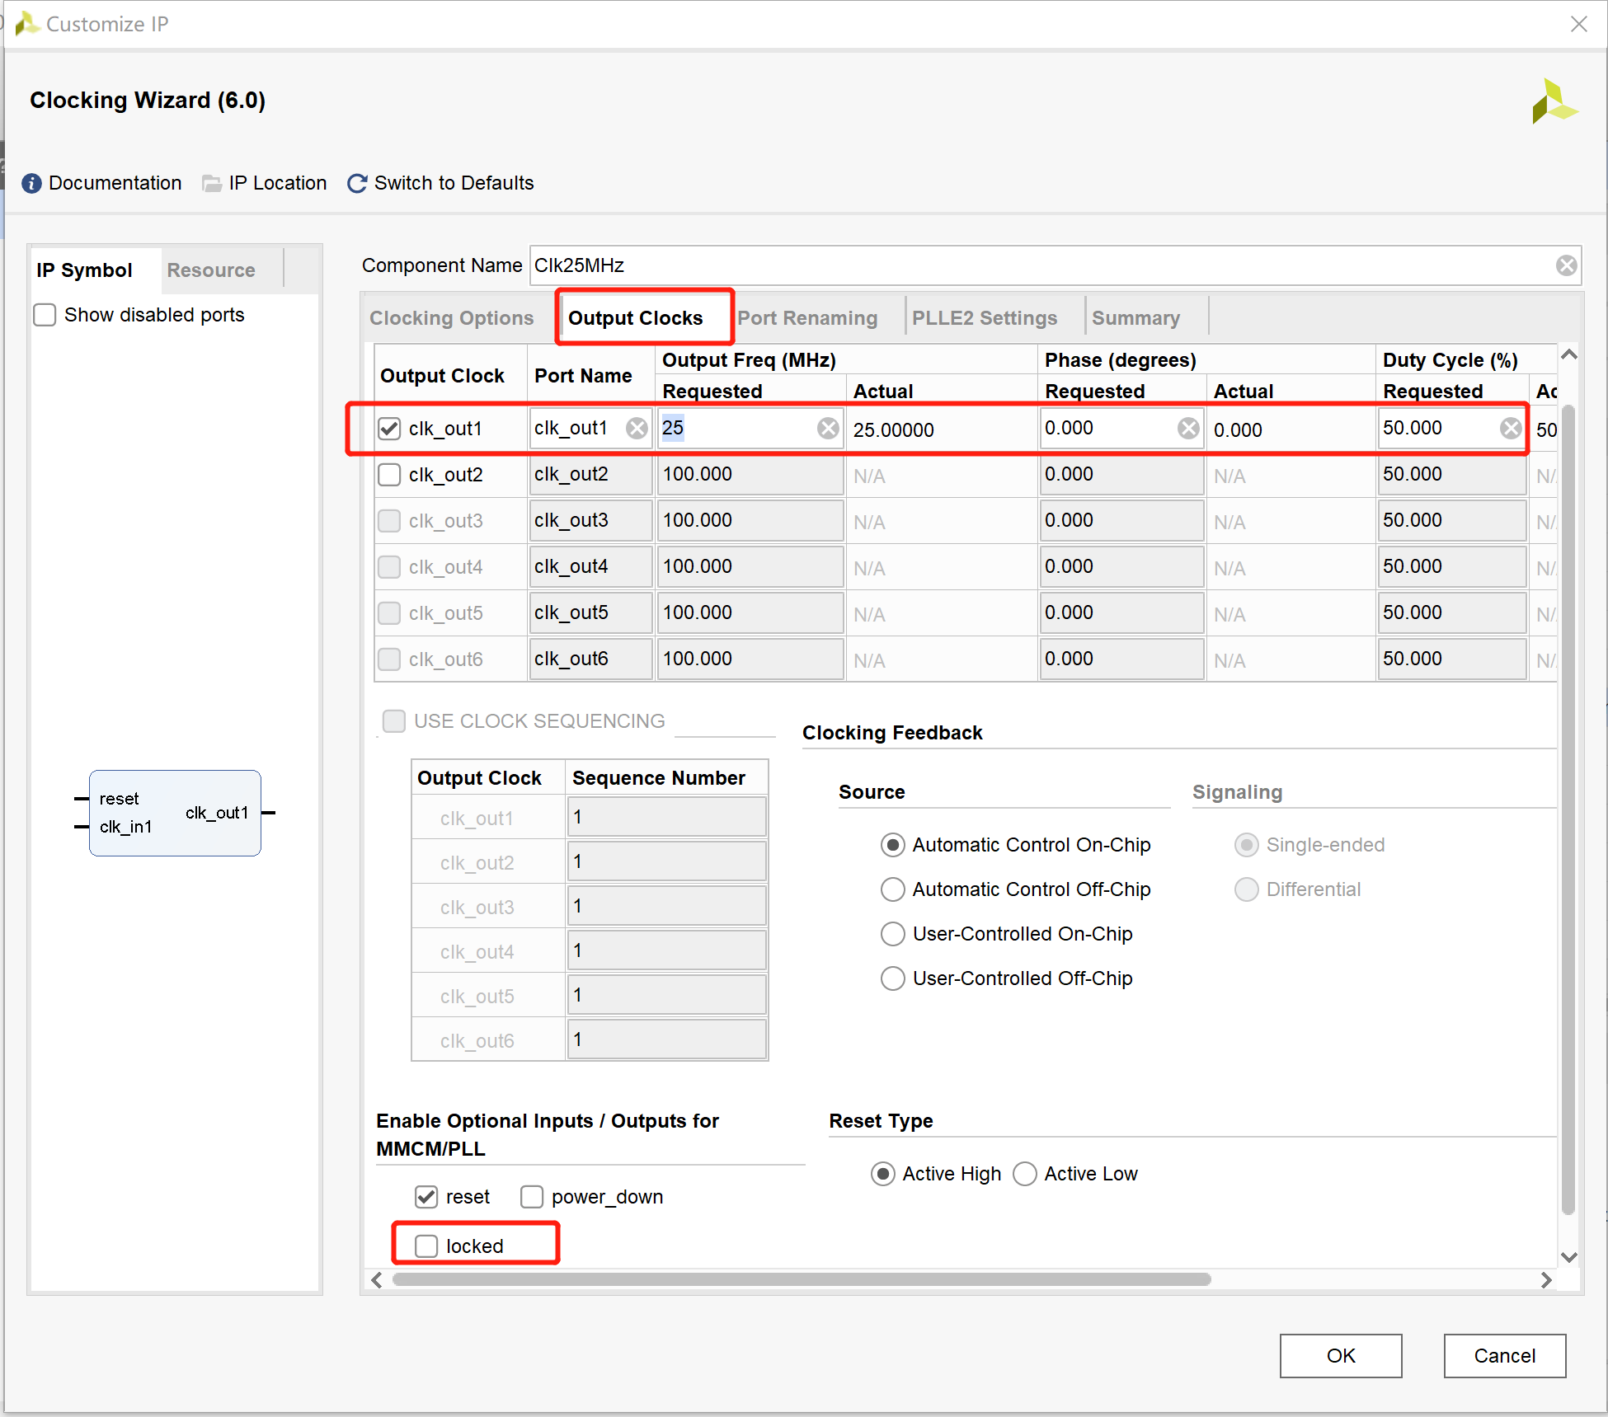
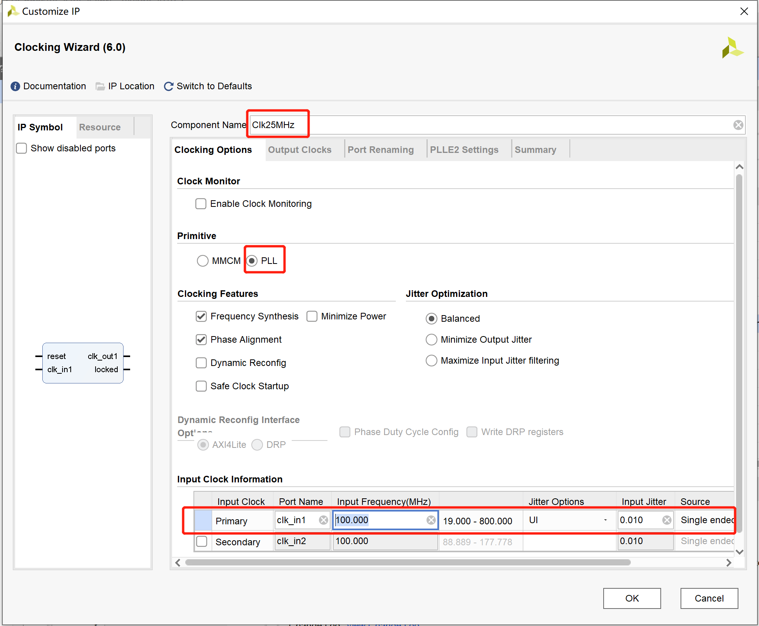
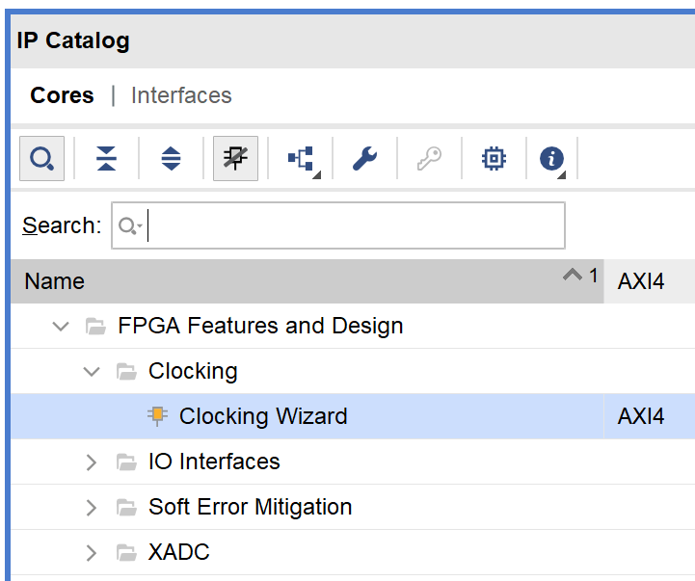
不同频率的时钟？
混合时钟管理器 MMCM
(Mixed-Mode Clock Manager)
可生成多个时钟
任意分频、倍频，如65MHz, 200MHz…
时钟管理块 CMT
(Clock Management Tiles)
提供时钟频率合成、倾斜矫正和抖动滤波功能
锁相环 PLL
(Phase-Locked Loop)
locked=1时，输出时钟才稳定

Slide 20
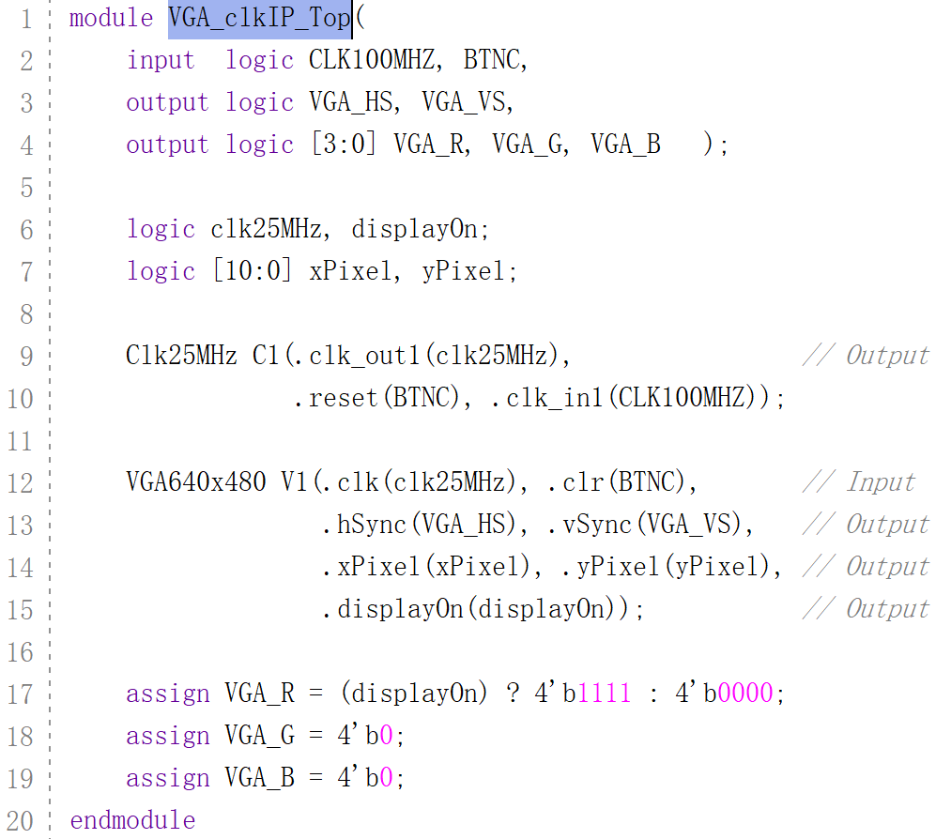
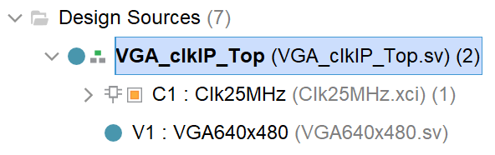
用PLL时钟

Slide 21
【作业1】SVGA 显示控制器设计
(Super VGA)
SVGA 800x600 pixels @72Hz
pixel rate: 50 MHz
horizontal display region: 800 pixels
horizontal retrace: 120 pixels
horizontal back porch: 56 pixels
horizontal front porch: 64 pixels
vertical display region: 600 lines
vertical retrace: 6 lines
vertical top: 37 lines
vertical bottom: 23 lines
SVGA 800x600 pixels @60Hz
pixel rate: 40 MHz
horizontal display region: 800 pixels
horizontal retrace: 128 pixels
horizontal back porch: 88 pixels
horizontal front porch: 40 pixels
vertical display region: 600 lines
vertical retrace: 4 lines
vertical top: 23 lines
vertical bottom: 1 lines

Slide 22
【作业1】XGA 显示控制器设计
(Extended Graphics Array)
XGA 1024x768 pixels @60Hz
pixel rate: 65 MHz (也可用50MHz代替)
horizontal display region: 1024 pixels
horizontal retrace: 136 pixels
horizontal back porch: 160 pixels
horizontal front porch: 24 pixels
vertical display region: 768 lines
vertical retrace: 6 lines
vertical top: 29 lines
vertical bottom: 3 lines
XGA 1280x1024 pixels @60Hz
pixel rate: 108 MHz
horizontal display region: 1280 pixels
horizontal retrace: 112 pixels
horizontal back porch: 248 pixels
horizontal front porch: 48 pixels
vertical display region: 1024 lines
vertical retrace: 3 lines
vertical top: 38 lines
vertical bottom: 1 lines

Slide 23
Picture
2
ping-pong

Slide 24
如何显示图像？
Object-mapped： 对于简单图形，直接在指定区域显示色彩。
Bit-mapped： 对于图片，将图片每个像素映射到屏幕上， 如果图片较大，则需要大量的内存资源。
Tile-mapped： 为减少内存需求，将重复使用的内容做成小块， 如，ASCII字符，分别做成16x8点阵字库。

Slide 25
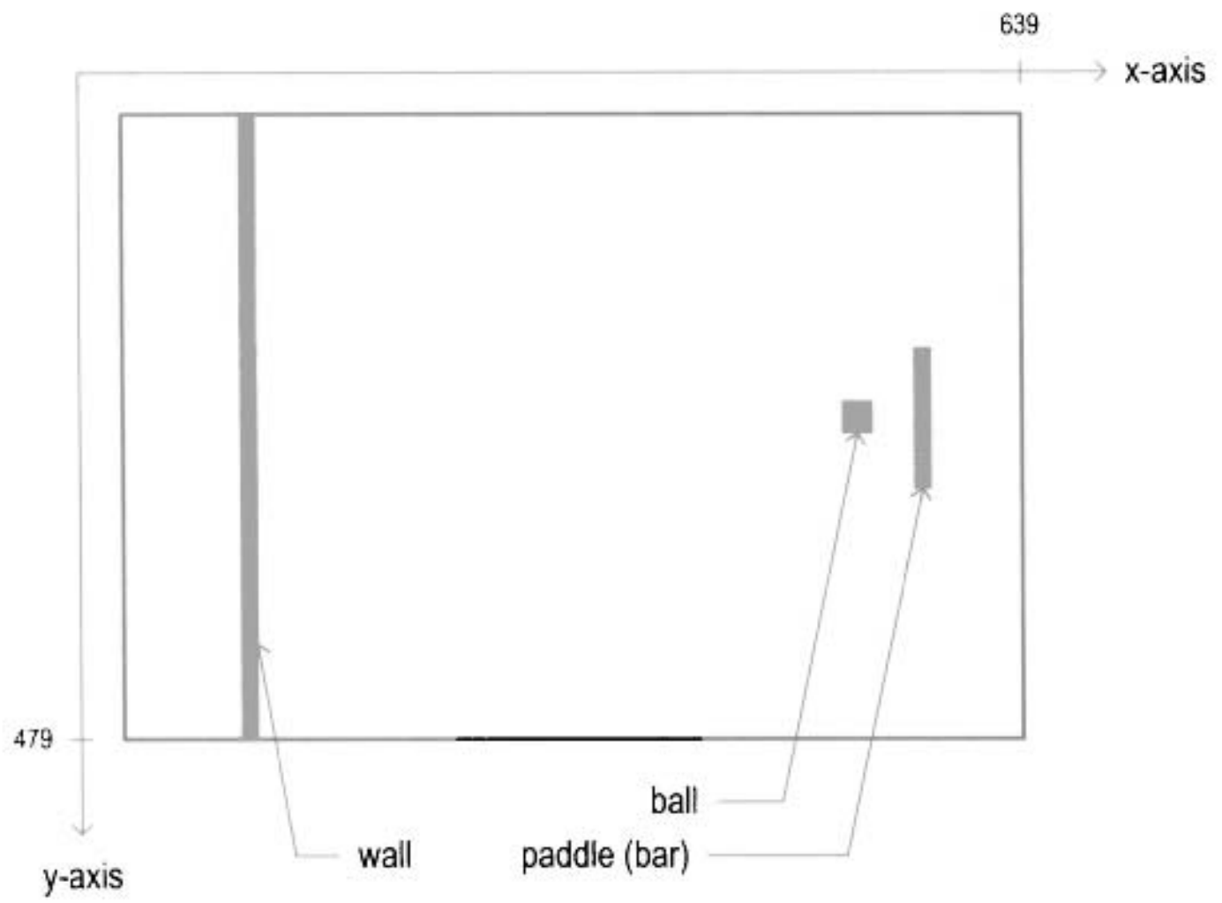
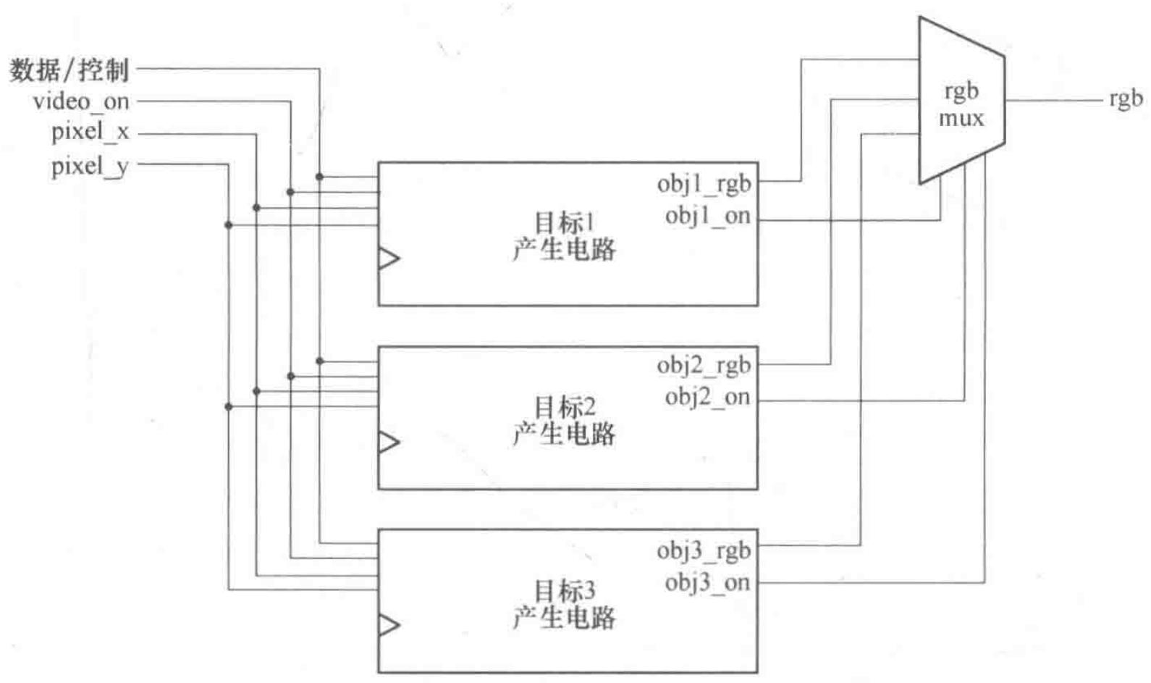
① Object-mapped
静止
对于简单几何图形，直接在指定区域显示颜色。

Slide 26
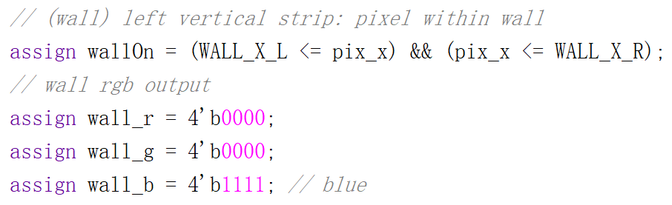
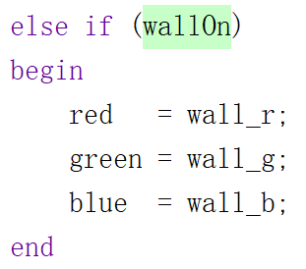
乒乓球：wall
静止
① Object-mapped

Slide 27
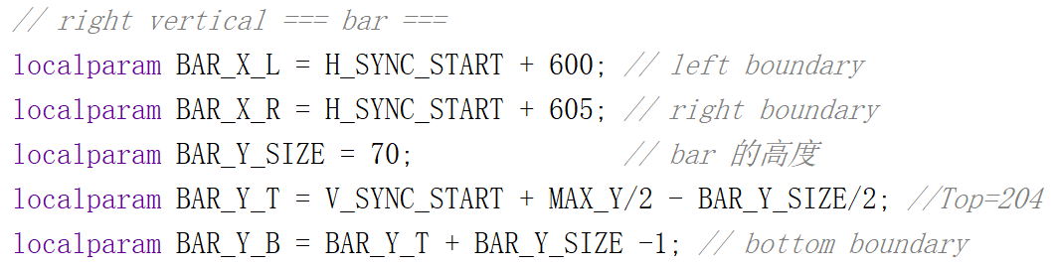
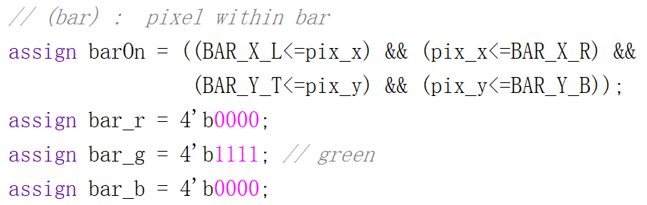
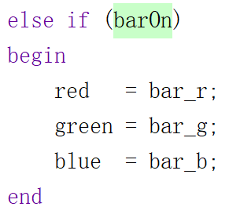
乒乓球：bar（球拍）
静止
① Object-mapped

Slide 28
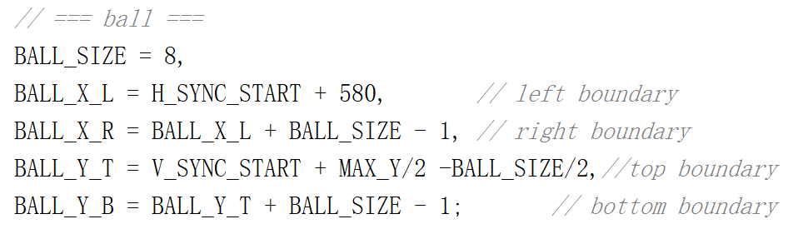
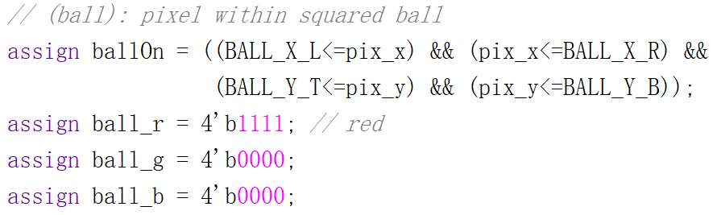

乒乓球：ball（方球）
静止
① Object-mapped

Slide 29



乒乓球：代码
静止
① Object-mapped
Notes:
module pingpong_screen_still( input logic videoOn,
input logic [10:0] pix_x, pix_y, //扫描屏幕坐标
output logic [3:0] red, green, blue );
localparam
MAX_X = 640, MAX_Y = 480, //(0.0) to (639,479)
// 屏幕参数
H_SYNC = 96, // horizontal sync width
H_BACK = 48, // left border (back porch)
H_SYNC_START = H_SYNC + H_BACK, //行显示后沿 = 144(96+48)
V_SYNC = 2, // vertical sync lines
V_TOP = 29, // vertical top border
V_SYNC_START = V_SYNC + V_TOP, //场显示后沿 = 31(2+29)
// === wall ===
WALL_X_L = H_SYNC_START + 30, // left boundary
WALL_X_R = H_SYNC_START + 40, // right boundary
// === bar ===
BAR_X_L = H_SYNC_START + 600, // left boundary
BAR_X_R = H_SYNC_START + 605, // right boundary
BAR_Y_SIZE = 70, // bar 的高度
BAR_Y_T = V_SYNC_START + MAX_Y/2 - BAR_Y_SIZE/2, //Top=204
BAR_Y_B = BAR_Y_T + BAR_Y_SIZE -1, // bottom boundary
// === ball ===
BALL_SIZE = 8,
BALL_X_L = H_SYNC_START + 580, // left boundary
BALL_X_R = BALL_X_L + BALL_SIZE - 1, // right boundary
BALL_Y_T = V_SYNC_START + MAX_Y/2 -BALL_SIZE/2,//top boundary
BALL_Y_B = BALL_Y_T + BALL_SIZE - 1; // bottom boundary
logic wallOn, barOn, ballOn;
logic [3:0] wall_r, wall_g, wall_b;
logic [3:0] bar_r, bar_g, bar_b;
logic [3:0] ball_r, ball_g, ball_b;
// (wall) : pixel within wall
assign wallOn = (WALL_X_L <= pix_x) && (pix_x <= WALL_X_R);
assign wall_r = 4'b0000;
assign wall_g = 4'b0000;
assign wall_b = 4'b1111; // blue
// (bar) : pixel within bar
assign barOn = ((BAR_X_L<=pix_x) && (pix_x<=BAR_X_R) &&
(BAR_Y_T<=pix_y) && (pix_y<=BAR_Y_B));
assign bar_r = 4'b0000;
assign bar_g = 4'b1111; // green
assign bar_b = 4'b0000;
// (ball): pixel within squared ball
assign ballOn = ((BALL_X_L<=pix_x) && (pix_x<=BALL_X_R) &&
(BALL_Y_T<=pix_y) && (pix_y<=BALL_Y_B));
assign ball_r = 4'b1111; // red
assign ball_g = 4'b0000;
assign ball_b = 4'b0000;
always_comb // ===== rgb 输出 ======
if (~videoOn)
begin
red = 4'b0000; // blank
green = 4'b0000; // blank
blue = 4'b0000; // blank
end
else if (wallOn)
begin
red = wall_r;
green = wall_g;
blue = wall_b;
end
else if (ballOn)
begin
red = ball_r;
green = ball_g;
blue = ball_b;
end
else if (barOn)
begin
red = bar_r;
green = bar_g;
blue = bar_b;
end
else
begin // gray background
red = 4'b1110;
green = 4'b1110;
blue = 4'b1110;
end
endmodule

Slide 30

乒乓球：顶层代码
静止
① Object-mapped
Notes:
module pingpong_screen_still_Top(
input logic CLK100MHZ, BTND, //为了操作方便
output logic VGA_HS, VGA_VS,
output logic [3:0] VGA_R, VGA_G, VGA_B);
logic clk25MHz, videoOn;
logic [10:0] pixel_x, pixel_y;
clkDiv C1(.clk(CLK100MHZ), .clr(BTND),
.clk25MHz(clk25MHz));
VGA640x480 V1(.clk(clk25MHz), .clr(BTND), // Input
.hSync(VGA_HS), .vSync(VGA_VS), // Output ***
.xPixel(pixel_x), .yPixel(pixel_y), // Output
.displayOn(videoOn)); // Output
pingpong_screen_still P1( .videoOn(videoOn),
.pix_x(pixel_x),
.pix_y(pixel_y),
.red(VGA_R), // Output ***
.green(VGA_G), // Output ***
.blue(VGA_B)); // Output ***
endmodule

Slide 31




乒乓球：ball（圆球）
静止
① Object-mapped
8x8圆型位图
圆球一行中某一列的像素值
Notes:
module pingpong_screen_stillR(
input logic videoOn,
input logic [10:0] pix_x, pix_y, //扫描屏幕坐标
output logic [3:0] red, green, blue );
localparam
MAX_X = 640, MAX_Y = 480, //(0.0) to (639,479)
// 屏幕参数
H_SYNC = 96, // horizontal sync width
H_BACK = 48, // left border (back porch)
H_SYNC_START = H_SYNC + H_BACK, //行显示后沿 = 144(96+48)
V_SYNC = 2, // vertical sync lines
V_TOP = 29, // vertical top border
V_SYNC_START = V_SYNC + V_TOP, //场显示后沿 = 31(2+29)
// === wall ===
WALL_X_L = H_SYNC_START + 30, // left boundary
WALL_X_R = H_SYNC_START + 40, // right boundary
// === bar ===
BAR_X_L = H_SYNC_START + 600, // left boundary
BAR_X_R = H_SYNC_START + 605, // right boundary
BAR_Y_SIZE = 70, // bar 的高度
BAR_Y_T = V_SYNC_START + MAX_Y/2 - BAR_Y_SIZE/2, //Top=204
BAR_Y_B = BAR_Y_T + BAR_Y_SIZE -1, // bottom boundary
// === ball ===
BALL_SIZE = 8,
BALL_X_L = H_SYNC_START + 580, // left boundary
BALL_X_R = BALL_X_L + BALL_SIZE - 1, // right boundary
BALL_Y_T = V_SYNC_START + MAX_Y/2 -BALL_SIZE/2,//top boundary
BALL_Y_B = BALL_Y_T + BALL_SIZE - 1; // bottom boundary
logic wallOn, barOn, ballOn, picOn;
logic [3:0] wall_r, wall_g, wall_b;
logic [3:0] bar_r, bar_g, bar_b;
logic [3:0] ball_r, ball_g, ball_b;
// (wall) : pixel within wall
assign wallOn = (WALL_X_L <= pix_x) && (pix_x <= WALL_X_R);
assign wall_r = 4'b0000;
assign wall_g = 4'b0000;
assign wall_b = 4'b1111; // blue
// (bar) : pixel within bar
assign barOn = ((BAR_X_L<=pix_x) && (pix_x<=BAR_X_R) &&
(BAR_Y_T<=pix_y) && (pix_y<=BAR_Y_B));
assign bar_r = 4'b0000;
assign bar_g = 4'b1111; // green
assign bar_b = 4'b0000;
/*
// (ball): pixel within squared ball
assign ballOn = ((BALL_X_L<=pix_x) && (pix_x<=BALL_X_R) &&
(BALL_Y_T<=pix_y) && (pix_y<=BALL_Y_B));
assign ball_r = 4'b1111; // red
assign ball_g = 4'b0000;
assign ball_b = 4'b0000;
*/
// === round ball ===
logic [2:0] rom_addr, rom_col; // ROM中8行、8列
logic rom_bit; // ROM中每个像素值
logic [7:0] rom_data;
always_comb // image ROM
case (rom_addr)
3'h0: rom_data = 8'b0011_1100; // ****
3'h1: rom_data = 8'b0111_1110; // ******
3'h2: rom_data = 8'b1111_1111; // ********
3'h3: rom_data = 8'b1111_1111; // ********
3'h4: rom_data = 8'b1111_1111; // ********
3'h5: rom_data = 8'b1111_1111; // ********
3'h6: rom_data = 8'b0111_1110; // ******
3'h7: rom_data = 8'b0011_1100; // ****
endcase
assign rom_col = pix_x[2:0] - BALL_X_L[2:0]; // ROM列
assign rom_addr = pix_y[2:0] - BALL_Y_T[2:0]; // ROM行
assign rom_bit = rom_data[rom_col]; //ROMaddr行中col列值
// pixel within ball
assign ballOn = ((BALL_X_L<=pix_x) && (pix_x<=BALL_X_R) &&
(BALL_Y_T<=pix_y) && (pix_y<=BALL_Y_B)) &
rom_bit; // round ball
assign ball_r = 4'b1111; // red
assign ball_g = 4'b0000; // red
assign ball_b = 4'b0000; // red
always_comb // ===== rgb 输出 ======
if (~videoOn)
begin
red = 4'b0000; // blank
green = 4'b0000; // blank
blue = 4'b0000; // blank
end
else if (wallOn)
begin
red = wall_r;
green = wall_g;
blue = wall_b;
end
else if (ballOn)
begin
red = ball_r;
green = ball_g;
blue = ball_b;
end
else if (barOn)
begin
red = bar_r;
green = bar_g;
blue = bar_b;
end
else
begin // gray background
red = 4'b1110;
green = 4'b1110;
blue = 4'b1110;
end
endmodule

Slide 32



乒乓球：bar （球拍）
运动
① Object-mapped

Slide 33




乒乓球：ball
运动
① Object-mapped
别忘记修改ROM中的球位置
Notes:
module pingpong_screen_move(
input logic clk, reset, //clk: 屏幕60Hz刷新频率
input logic btnUp, btnDown, //控制Bar上下移动
input logic videoOn,
input logic [10:0] pix_x, pix_y, //扫描屏幕坐标
output logic [3:0] red, green, blue );
localparam
MAX_X = 640, MAX_Y = 480, //(0.0) to (639,479)
// 屏幕参数
H_SYNC = 96, // horizontal sync width
H_BACK = 48, // left border (back porch)
H_SYNC_START = H_SYNC + H_BACK, //行显示后沿 = 144(96+48)
V_SYNC = 2, // vertical sync lines
V_TOP = 29, // vertical top border
V_SYNC_START = V_SYNC + V_TOP, //场显示后沿 = 31(2+29)
// === wall ===
WALL_X_L = H_SYNC_START + 30, // left boundary
WALL_X_R = H_SYNC_START + 40, // right boundary
// === bar ===
BAR_X_L = H_SYNC_START + 600, // left boundary
BAR_X_R = H_SYNC_START + 605, // right boundary
BAR_Y_SIZE = 70, // bar 的高度
BAR_Y_T = V_SYNC_START + MAX_Y/2 - BAR_Y_SIZE/2, //Top=204
BAR_Y_B = BAR_Y_T + BAR_Y_SIZE -1, // bottom boundary
BAR_V = 4, // 每次移动 bar 的距离
// === ball ===
BALL_SIZE = 8,
BALL_X_L = H_SYNC_START + 580, // left boundary
BALL_X_R = BALL_X_L + BALL_SIZE - 1, // right boundary
BALL_Y_T = V_SYNC_START + MAX_Y/2 -BALL_SIZE/2,//top boundary
BALL_Y_B = BALL_Y_T + BALL_SIZE - 1, // bottom boundary
BALL_V = 2; // 每次移动 ball 的距离
logic wallOn, barOn, ballOn;
logic [3:0] wall_r, wall_g, wall_b;
logic [3:0] bar_r, bar_g, bar_b;
logic [3:0] ball_r, ball_g, ball_b;
// (wall) : pixel within wall
assign wallOn = (WALL_X_L <= pix_x) && (pix_x <= WALL_X_R);
assign wall_r = 4'b0000;
assign wall_g = 4'b0000;
assign wall_b = 4'b1111; // blue
// (bar) : pixel within bar
logic [10:0] bar_y_t, bar_y_b; // bar top, bottom boundary
// new bar y-position
always @(posedge clk, posedge reset)
begin
if (reset)
begin
bar_y_t <= BAR_Y_T;
end
else if (btnDown & (bar_y_b <= (V_SYNC_START+MAX_Y-1-BAR_V)))
bar_y_t <= bar_y_t + BAR_V; // move down
else if (btnUp & (bar_y_t >= (V_SYNC_START+BAR_V)))
bar_y_t <= bar_y_t - BAR_V; // move up
end
assign bar_y_b = bar_y_t + BAR_Y_SIZE - 1;
assign barOn = ((BAR_X_L<=pix_x) && (pix_x<=BAR_X_R) &&
(bar_y_t<=pix_y) && (pix_y<=bar_y_b)); //变量
assign bar_r = 4'b0000;
assign bar_g = 4'b1111; // green
assign bar_b = 4'b0000;
/*
// (ball): pixel within squared ball
assign ballOn = ((BALL_X_L<=pix_x) && (pix_x<=BALL_X_R) &&
(BALL_Y_T<=pix_y) && (pix_y<=BALL_Y_B));
assign ball_r = 4'b1111; // red
assign ball_g = 4'b0000;
assign ball_b = 4'b0000;
*/
// （round ball）
logic [10:0] ball_x_l, ball_x_r; // ball left, right boundary
logic [10:0] ball_y_t, ball_y_b; // ball top, bottom boundary
logic [10:0] ball_dx , ball_dy ; // ball x, y 增量
// new ball x,y-position
always @(posedge clk, posedge reset) begin
if (reset) begin
ball_x_l <= BALL_X_L;
ball_y_t <= BALL_Y_T;
ball_dx <= -1 * BALL_V;
ball_dy <= -1 * BALL_V;
end
else begin
ball_x_l <= ball_x_l + ball_dx;
ball_y_t <= ball_y_t + ball_dy;
// ------------------ ball bounce back -----------------------
if (ball_y_t <= V_SYNC_START) //reach top screen
ball_dy <= BALL_V;
else if (ball_y_b >= V_SYNC_START + MAX_Y) //reach bottom screen
ball_dy <= -1 * BALL_V;
else if (ball_x_l <= WALL_X_R) //reach left wall
ball_dx <= BALL_V;
else if ((ball_x_r >= BAR_X_L) && //reach right bar
(ball_x_r <= BAR_X_R) &&
(ball_y_b >= bar_y_t) && (ball_y_t <= bar_y_b))
ball_dx <= -1 * BALL_V;
else if (ball_x_r >= H_SYNC_START + MAX_X) //reach right screen
ball_dx <= -1 * BALL_V;
end
end
assign ball_x_r = ball_x_l + BALL_SIZE - 1;
assign ball_y_b = ball_y_t + BALL_SIZE - 1;
logic [2:0] rom_addr, rom_col; // ROM中8行、8列
logic rom_bit; // ROM中每个像素值
logic [7:0] rom_data;
always_comb // image ROM
case (rom_addr)
3'h0: rom_data = 8'b0011_1100; // ****
3'h1: rom_data = 8'b0111_1110; // ******
3'h2: rom_data = 8'b1111_1111; // ********
3'h3: rom_data = 8'b1111_1111; // ********
3'h4: rom_data = 8'b1111_1111; // ********
3'h5: rom_data = 8'b1111_1111; // ********
3'h6: rom_data = 8'b0111_1110; // ******
3'h7: rom_data = 8'b0011_1100; // ****
endcase
assign rom_col = pix_x[2:0] - ball_x_l[2:0]; // ROM列
assign rom_addr = pix_y[2:0] - ball_y_t[2:0]; // ROM行
assign rom_bit = rom_data[rom_col]; //ROMaddr行中col列值
// pixel within ball
assign ballOn = ((ball_x_l<=pix_x) && (pix_x<=ball_x_r) && //变量
(ball_y_t<=pix_y) && (pix_y<=ball_y_b)) & //变量
rom_bit; // round ball
assign ball_r = 4'b1111; // red
assign ball_g = 4'b0000; // red
assign ball_b = 4'b0000; // red
always_comb // ===== rgb 输出 ======
if (~videoOn)
begin
red = 4'b0000; // blank
green = 4'b0000; // blank
blue = 4'b0000; // blank
end
else if (wallOn)
begin
red = wall_r;
green = wall_g;
blue = wall_b;
end
else if (ballOn)
begin
red = ball_r;
green = ball_g;
blue = ball_b;
end
else if (barOn)
begin
red = bar_r;
green = bar_g;
blue = bar_b;
end
else
begin // gray background
red = 4'b1110;
green = 4'b1110;
blue = 4'b1110;
end
endmodule

Slide 34

乒乓球：顶层代码
运动
① Object-mapped
Notes:
module pingpong_screen_move_Top(
input logic CLK100MHZ, BTND, //为了操作方便
input logic BTNU, BTNC, //控制Bar上下
output logic VGA_HS, VGA_VS,
output logic [3:0] VGA_R, VGA_G, VGA_B);
logic clk25MHz, clk60Hz, videoOn;
logic [10:0] pixel_x, pixel_y;
clkDiv C1(.clk(CLK100MHZ), .clr(BTND),
.clk25MHz(clk25MHz));
VGA640x480 V1(.clk(clk25MHz), .clr(BTND), // Input
.hSync(VGA_HS), .vSync(VGA_VS), // Output ***
.xPixel(pixel_x), .yPixel(pixel_y), // Output
.displayOn(videoOn)); // Output
clk60Hz C2(.clk(CLK100MHZ), .clr(BTND), .clk60Hz(clk60Hz));
pingpong_screen_move P1(.clk(clk60Hz), .reset(BTND),
.btnUp(BTNU), .btnDown(BTNC),
.videoOn(videoOn),
.pix_x(pixel_x),
.pix_y(pixel_y),
.red(VGA_R), // Output ***
.green(VGA_G), // Output ***
.blue(VGA_B)); // Output ***
endmodule

Slide 35
【作业2】越狱游戏
左侧的墙被多层砖块替代，当小球撞击到砖块时， 小球被弹回， 同时被撞击的砖块消失。

Slide 36








参考资料
Nexys4-DDR_Reference Manual.pdf

